Slide 1

LRGASP: Challenge 3
evaluation results
Francisco J. Pardo-Palacios, Ana Conesa
On behalf of the LRGASP evaluation team

Slide 2
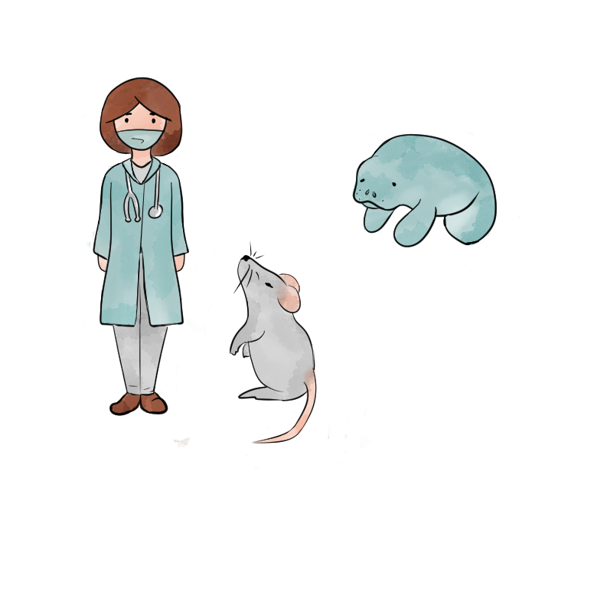

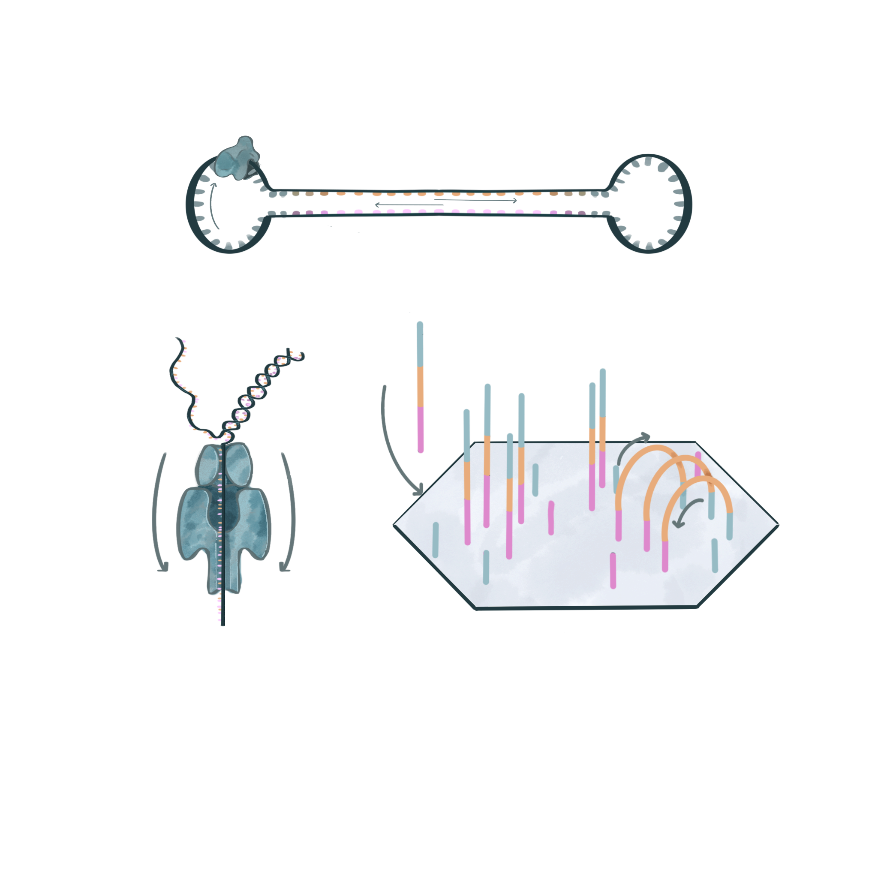
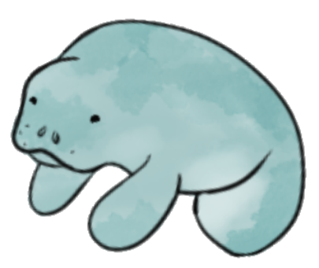
LRGASP
3 species
4 sample types
4 library protocols
3 sequencing
platforms
cDNA
one cell type
Sequel II
human
direct RNA
cell mixtures
mouse
MinION
R2C2
spike-ins
manatee
synthetic data
CapTrap
HiSeq

Slide 3
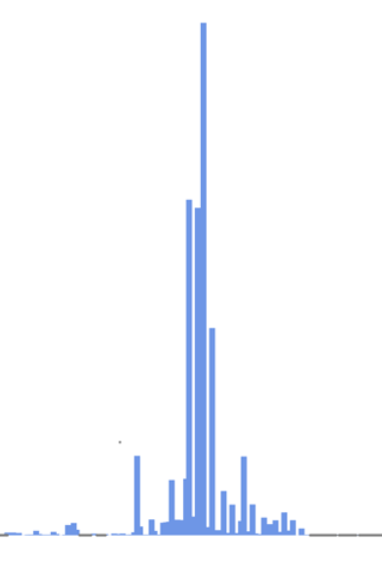
LRGASP Challenge 3: De novo Transcript identification
Sample types
Library protocols
Sequencing
platforms
Analysis options
Long Only
cDNA
Sequel II
Mouse ES
Long & Short
direct RNA
MinION
Short only
R2C2
Manatee
CapTrap
HiSeq
Free style

Slide 4
Evaluation code of conduct
The LRGASP evaluation team is composed by groups who did NOT participate in the challenge (did not submit predictions)
  Ana Conesa and Fran Pardo (SQANTI developers)
  Gloria Sheynkman (experimental validation lead)
  Kin Fai, Dingjie Wang, Haoran Li (Challenge 2 evaluators)
  Adam Frankish and Jane Loveland (GENCODE)
  Mark Diekhans (UCSC Genome Browser)
  Maite de María, Maggie Hunter and Nancy Denslow (manatee UF team)
Results were discussed without disclosing the name of the submitting labs (only known to the Conesa lab)
Each lab received an evaluation report of their submissions

Slide 5
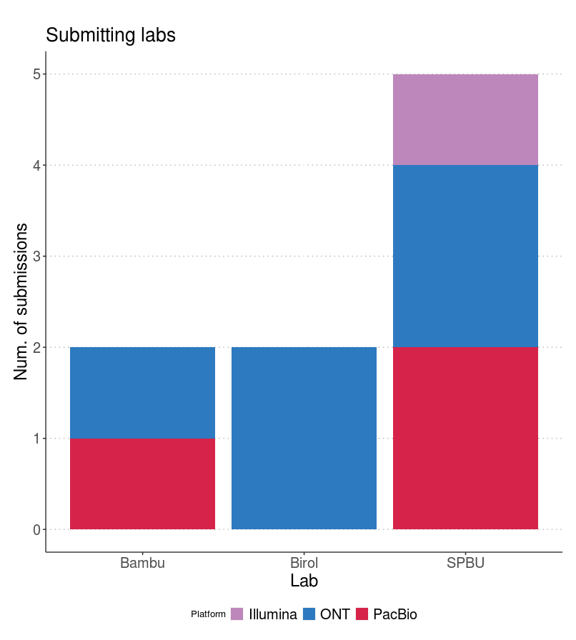
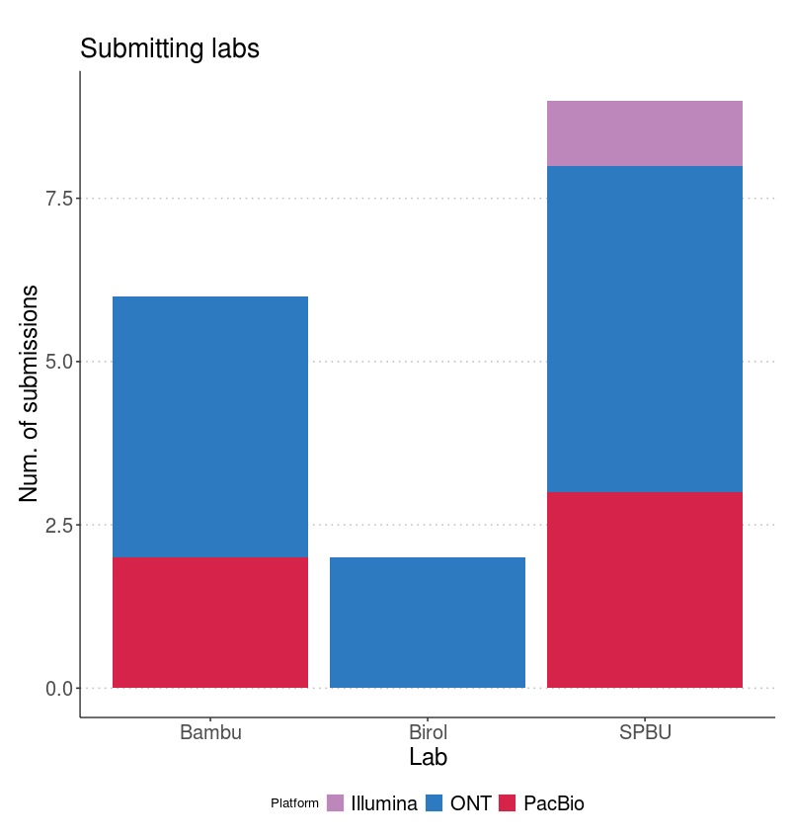
Overview of the participation effort
Total submitted entries: 17
    Manatee data → only cDNA PacBio, cDNA ONT and Illumina data
      Total: 9 submissions
    Mouse data → R2C2, dRNA, cDNA and CapTrap with ONT + cDNA and CapTrap with PacBio
      Total: 17 submissions
manatee
mouse

Slide 6
Comparative evaluation for mouse samples

Slide 7
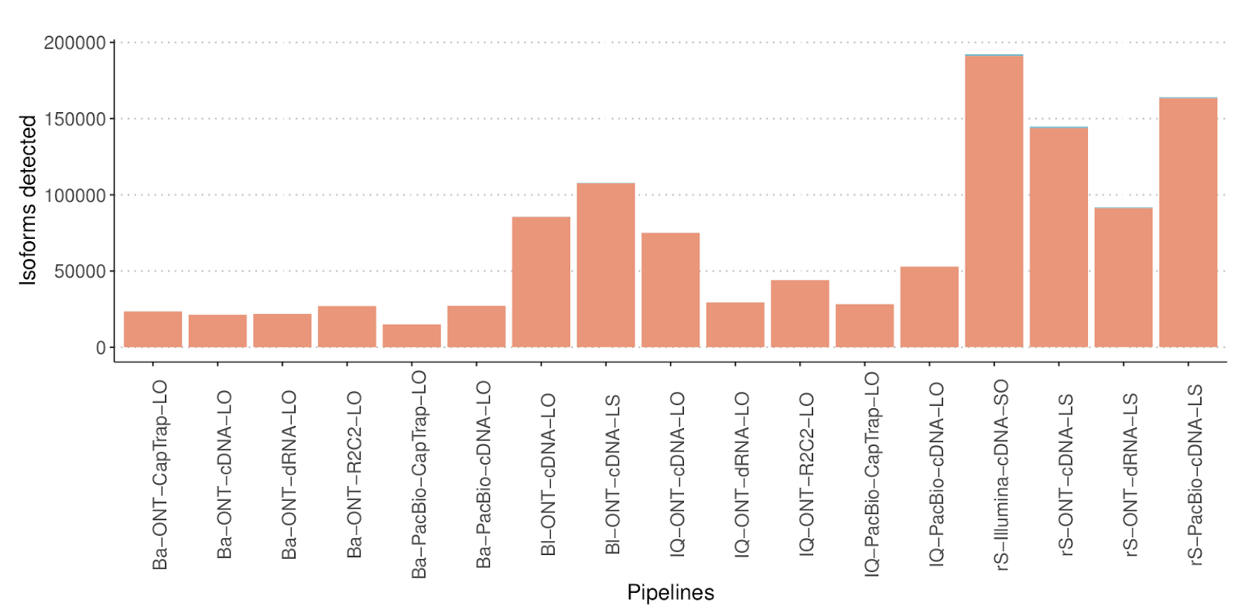
Num. Isoforms detected

Slide 8
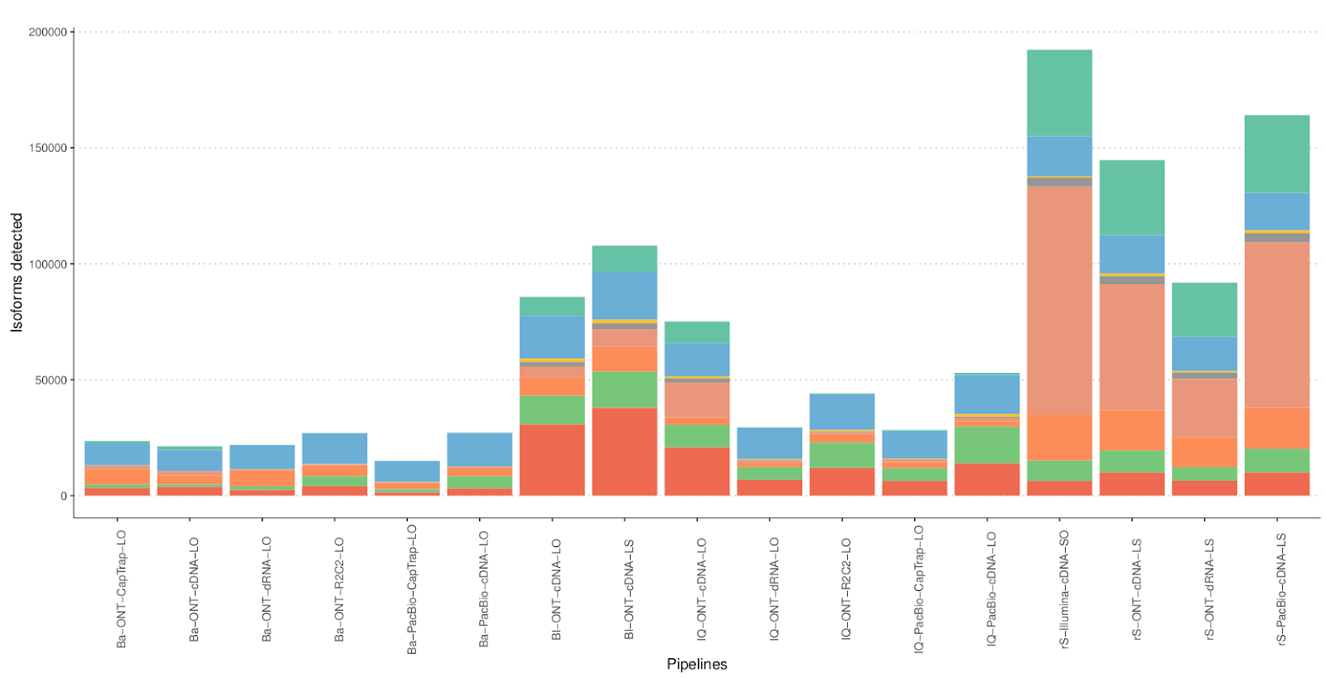
Number isoforms detected

Slide 9
Number isoforms detected
Challenge 1 results

Slide 10
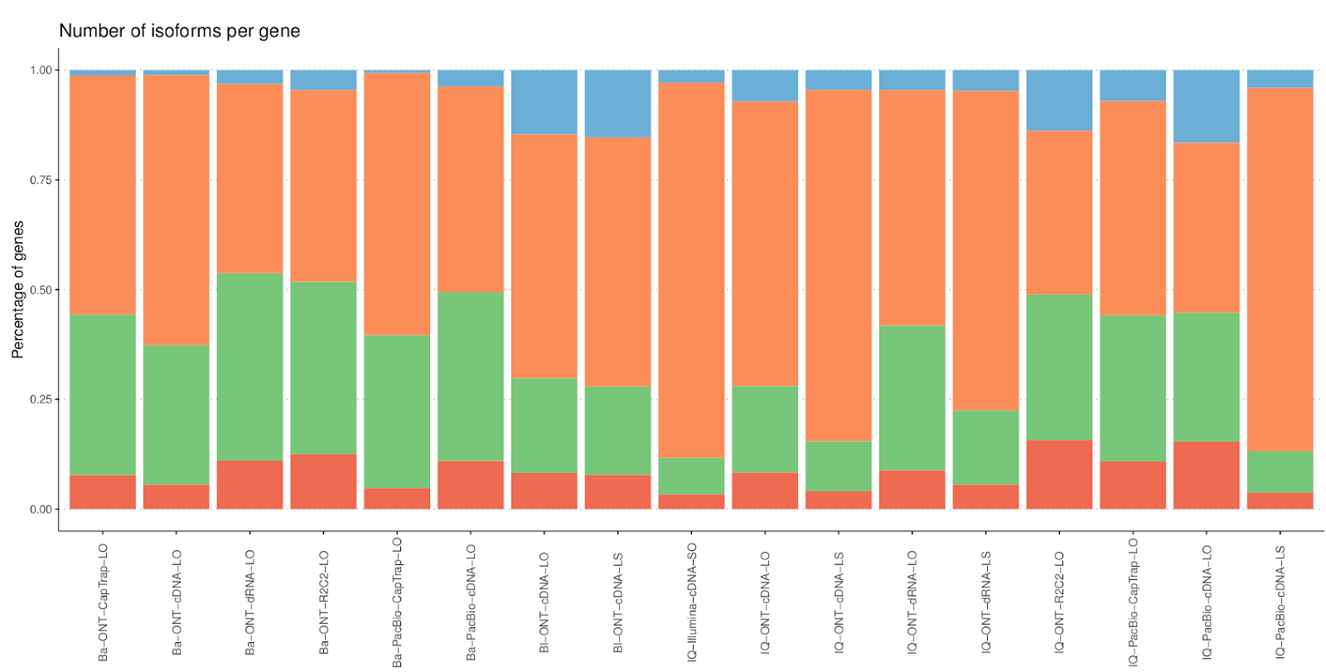
Num. Isoforms per gene

Slide 11
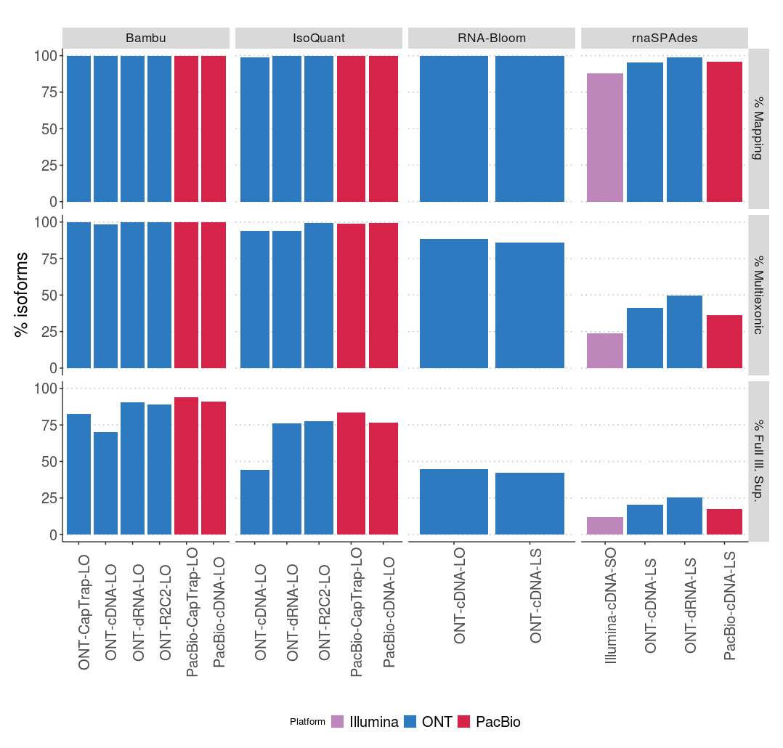
Challenge 3 metrics
% Mapping to genome
% Multi-exonic isoforms
% Full Illumina support

Slide 12
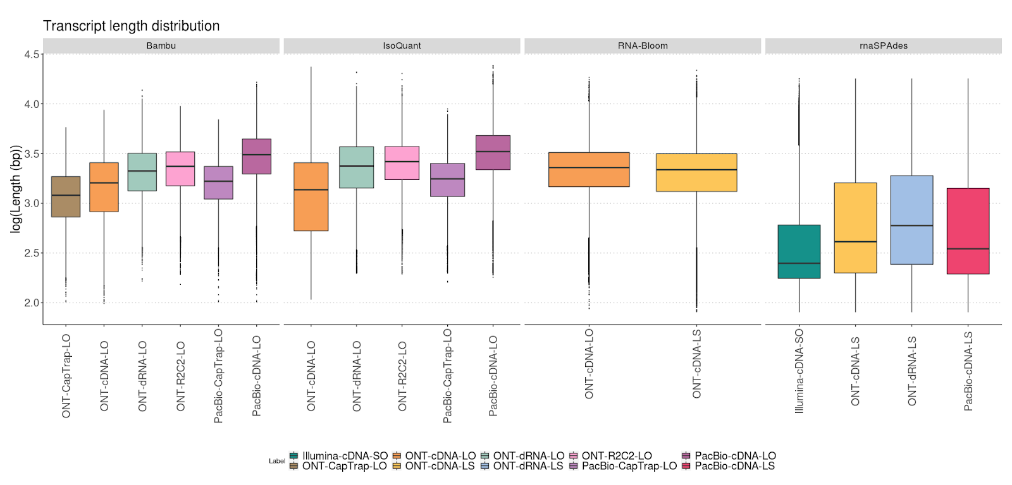
Length distribution

Slide 13
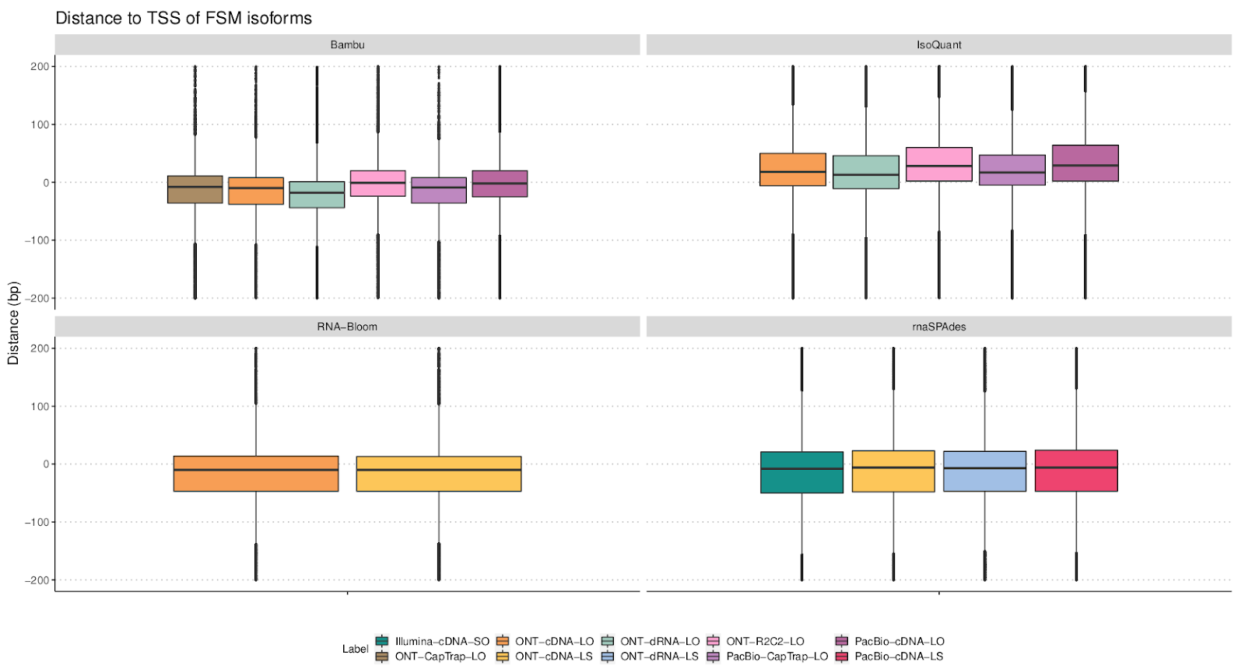
Distance to TSS of FSM
Challenge 1 results

Slide 14
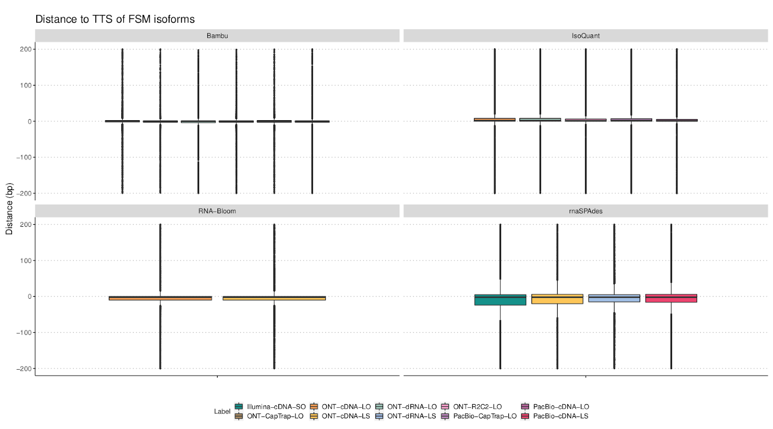
Distance to TTS of FSM

Slide 15
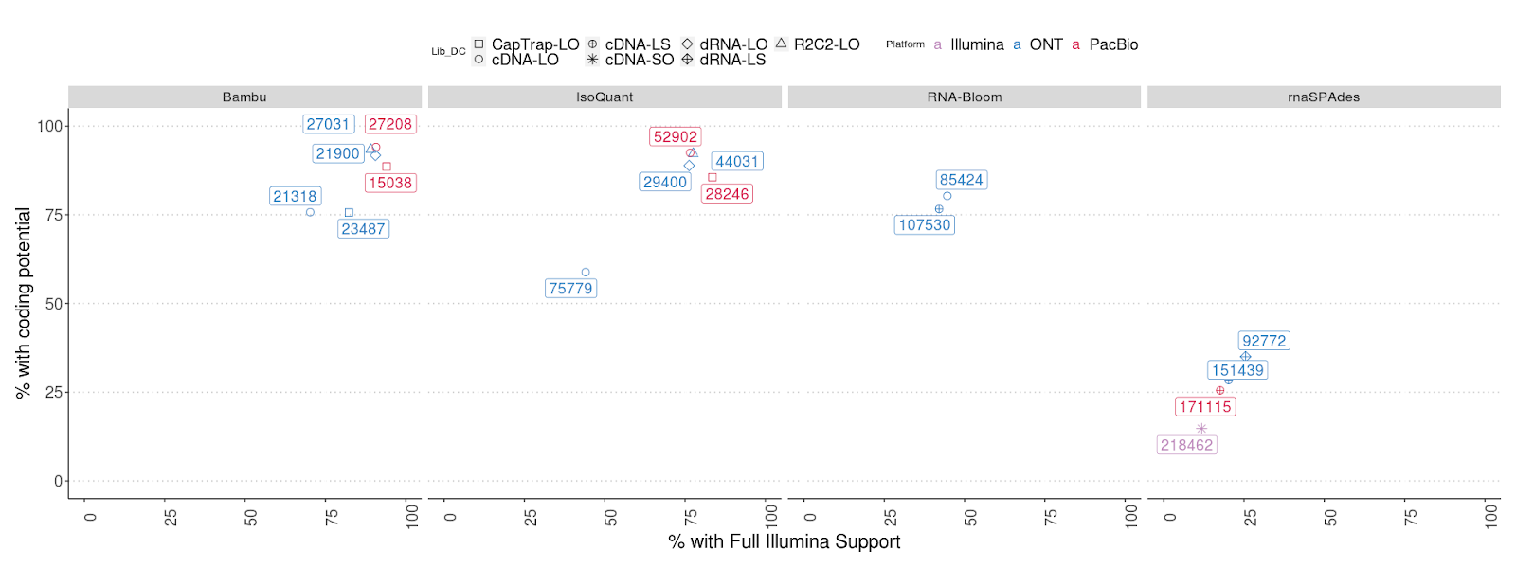
% Full Illumina support vs % Coding transcripts

Slide 16
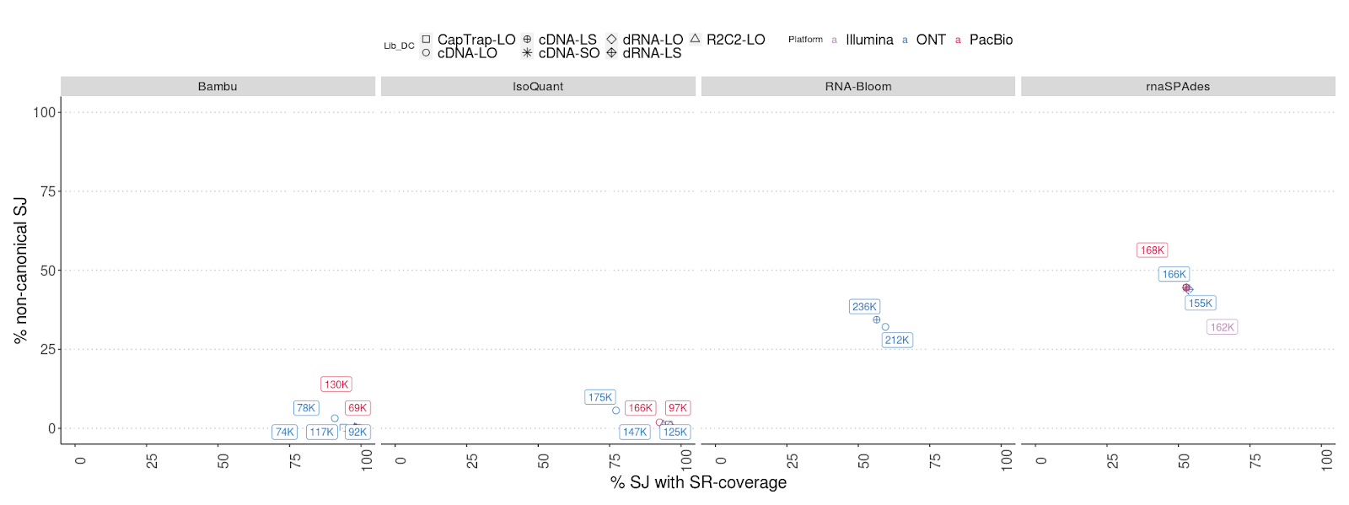
% non-canonical SJ vs % SJ with SR coverage

Slide 17
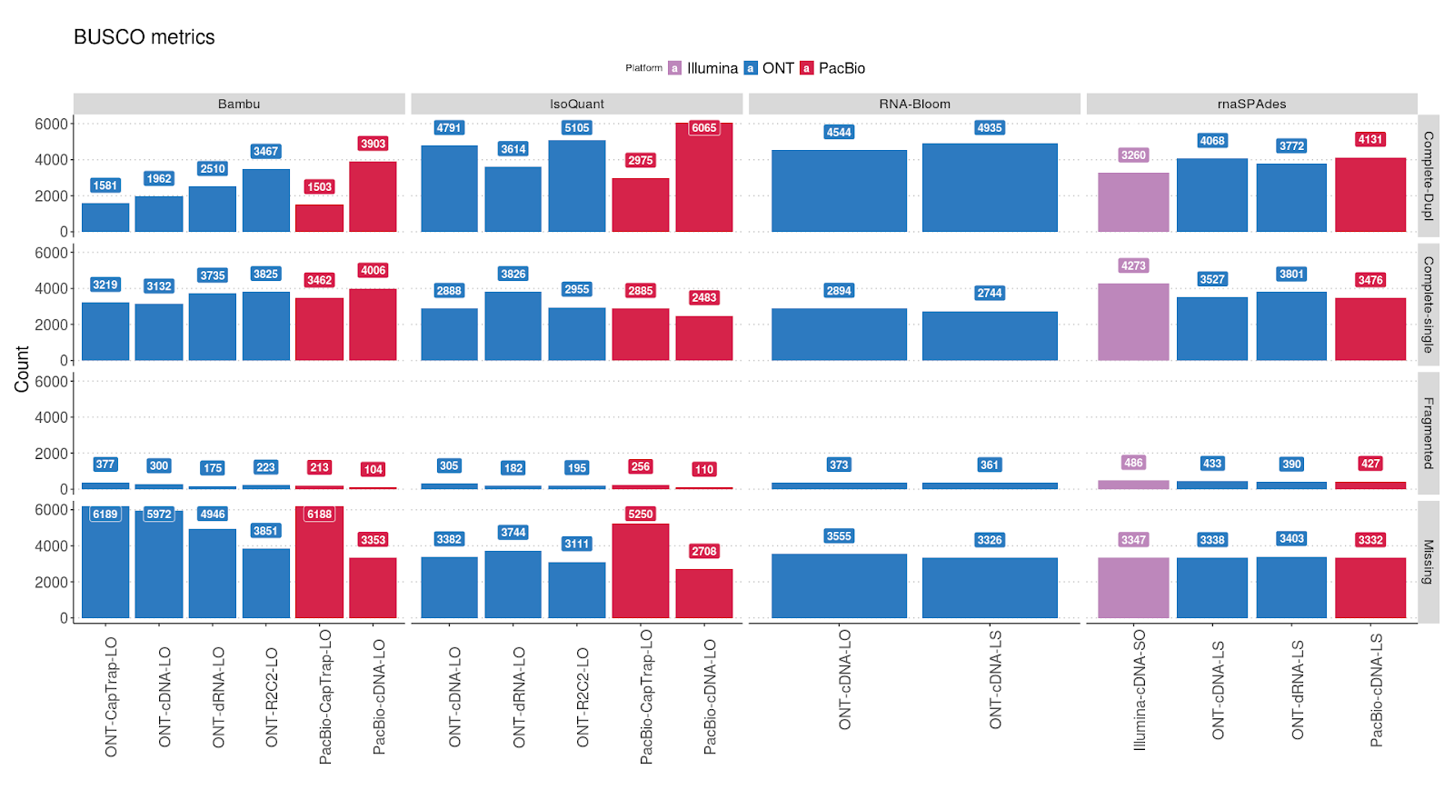
BUSCO Analysis

Slide 18
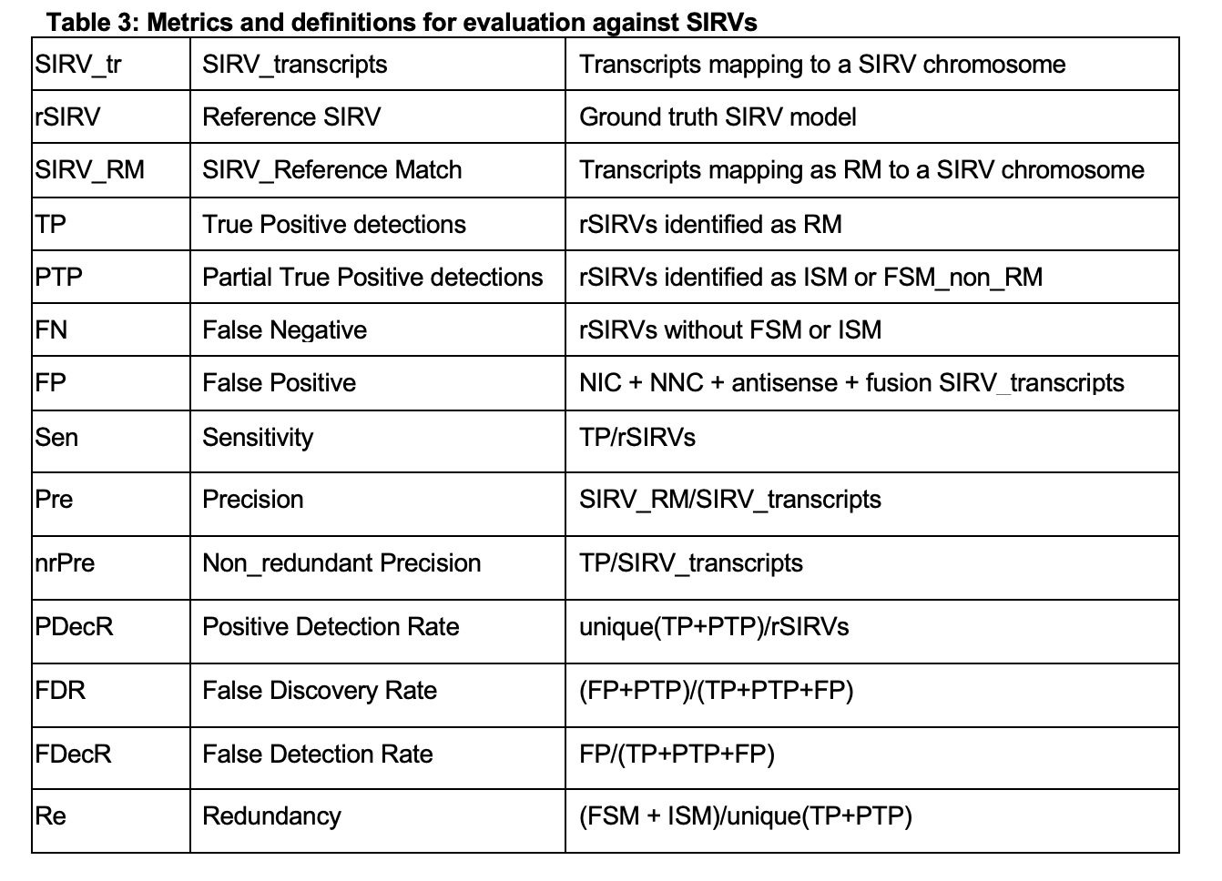
Evaluation Metrics for SIRVs

Slide 19
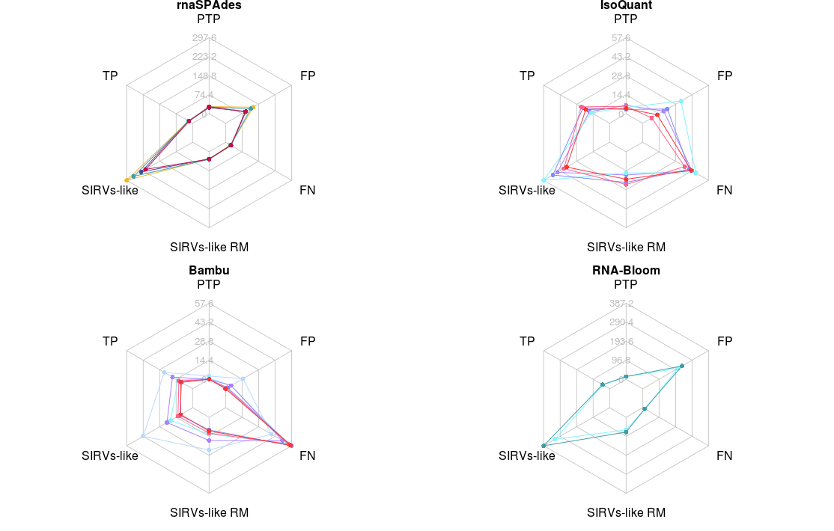
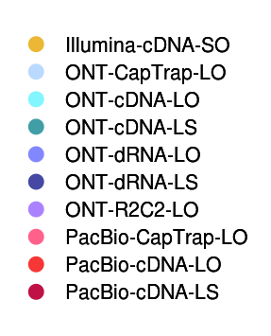
Evaluation Metrics for SIRVs
Challenge 1 results
Challenge 1 results

Slide 20
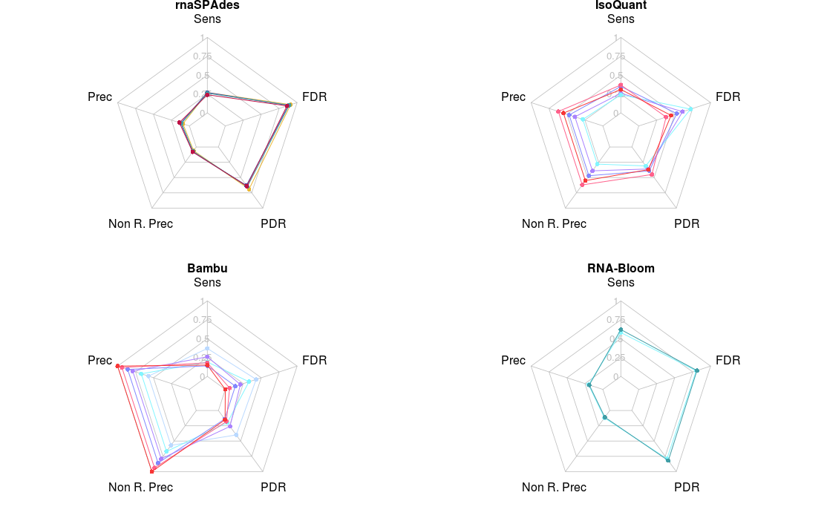
Evaluation Metrics for SIRVs
Challenge 1 results
Challenge 1 results

Slide 21
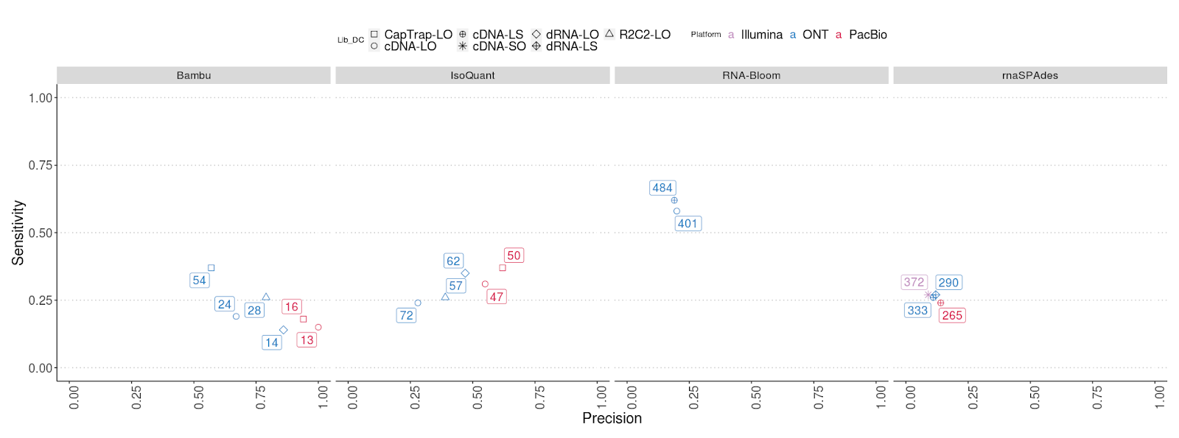
Sensitivity vs Precision

Slide 22
Comparative evaluation for manatee samples
Extra challenges:
* Poorly characterized organism
* Blood sample
* 15%-30% SIRV reads

Slide 23
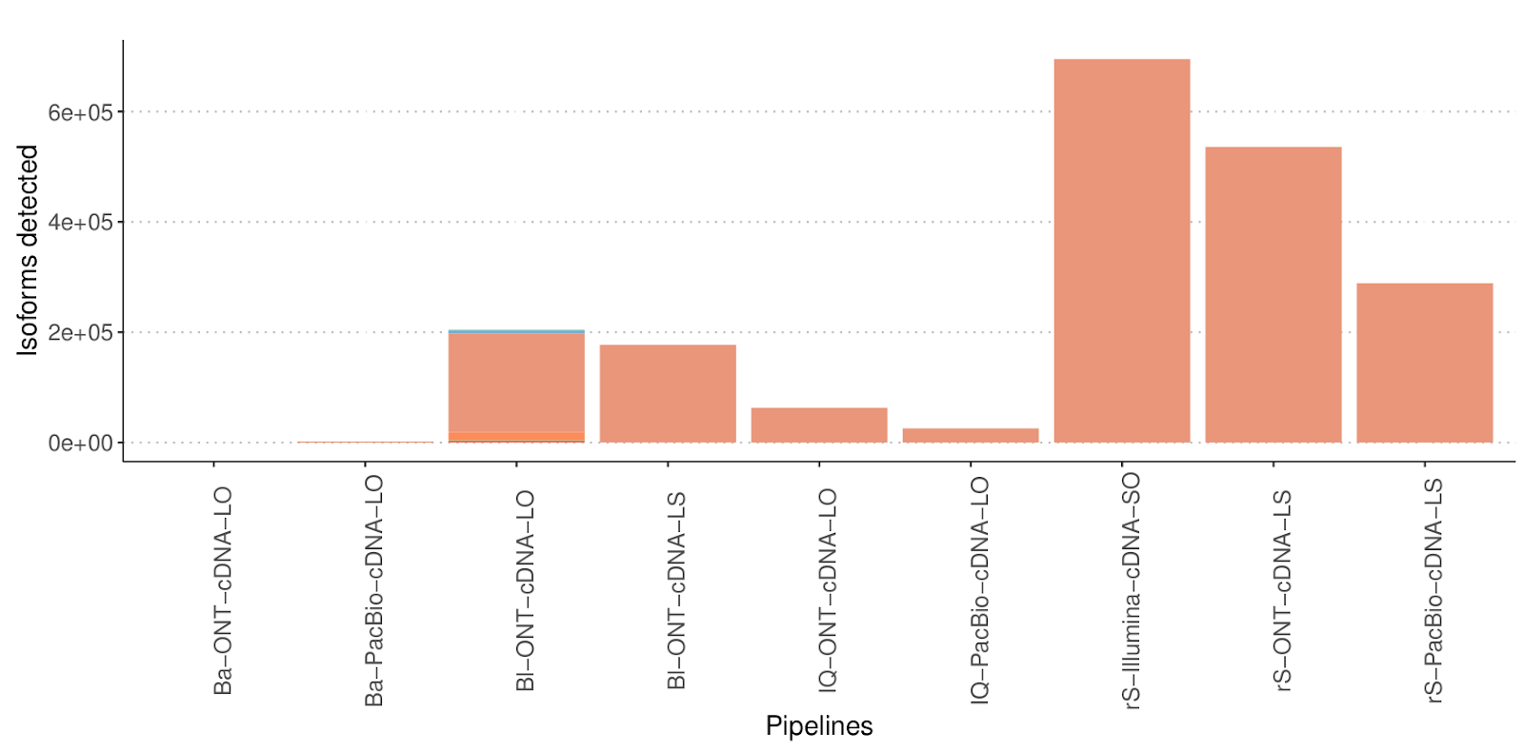
Num. isoforms

Slide 24
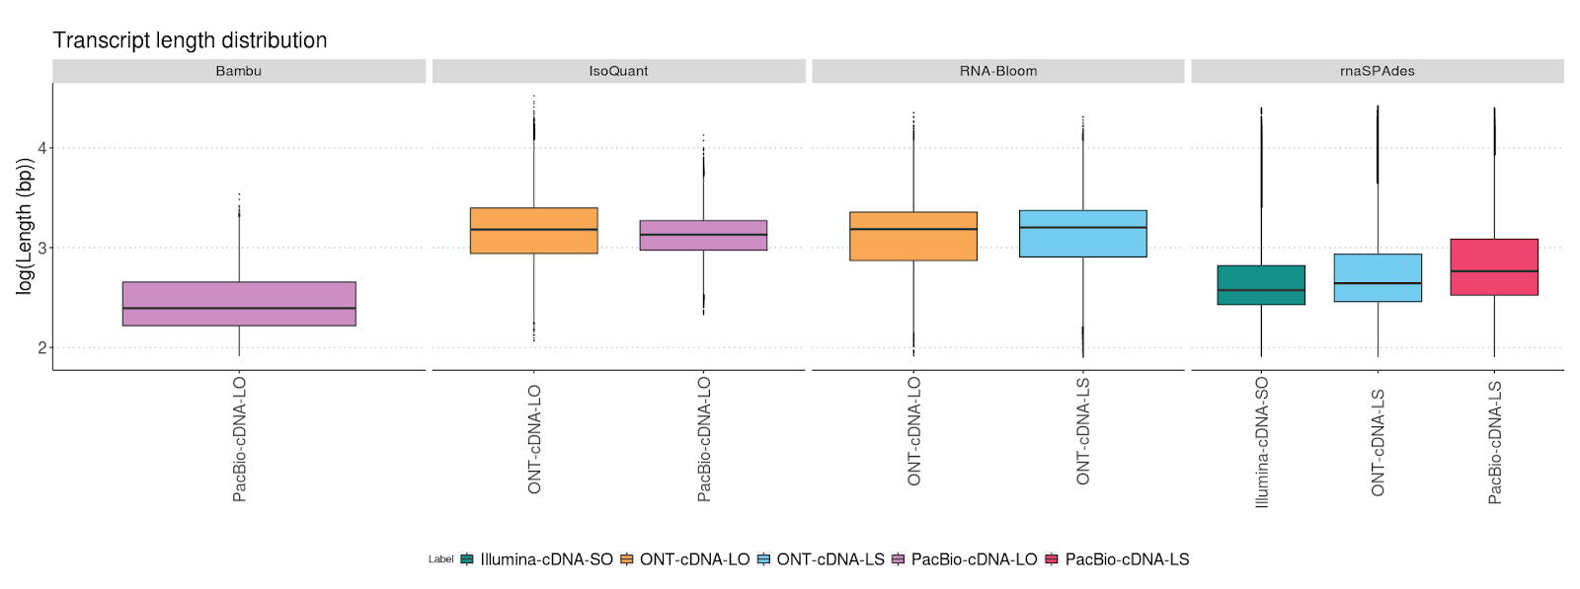
Length distribution

Slide 25
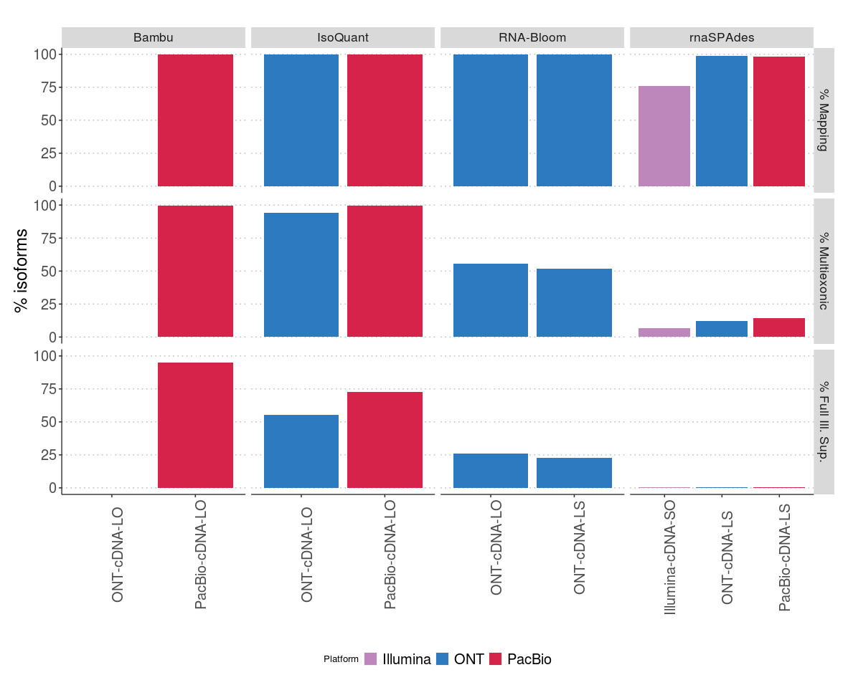
Challenge 3 metrics
% Mapping:
% Multi-exonic isoforms
% Full Illumina support

Slide 26
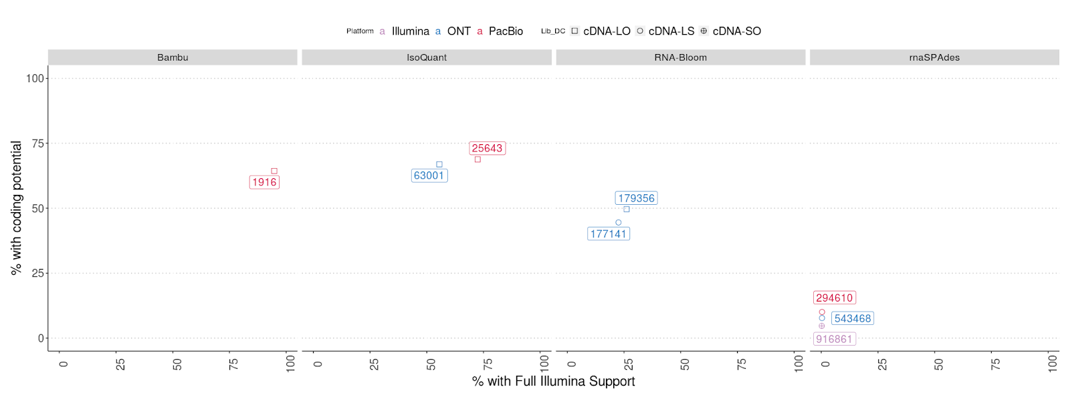
% Full Illumina support vs % Coding transcripts

Slide 27
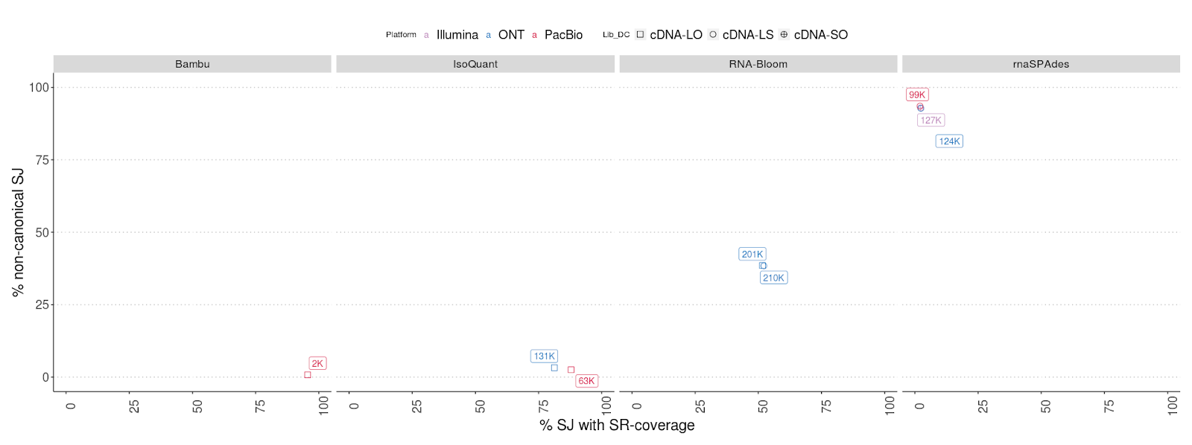
% non-canonical SJ vs % SJ with SR coverage

Slide 28
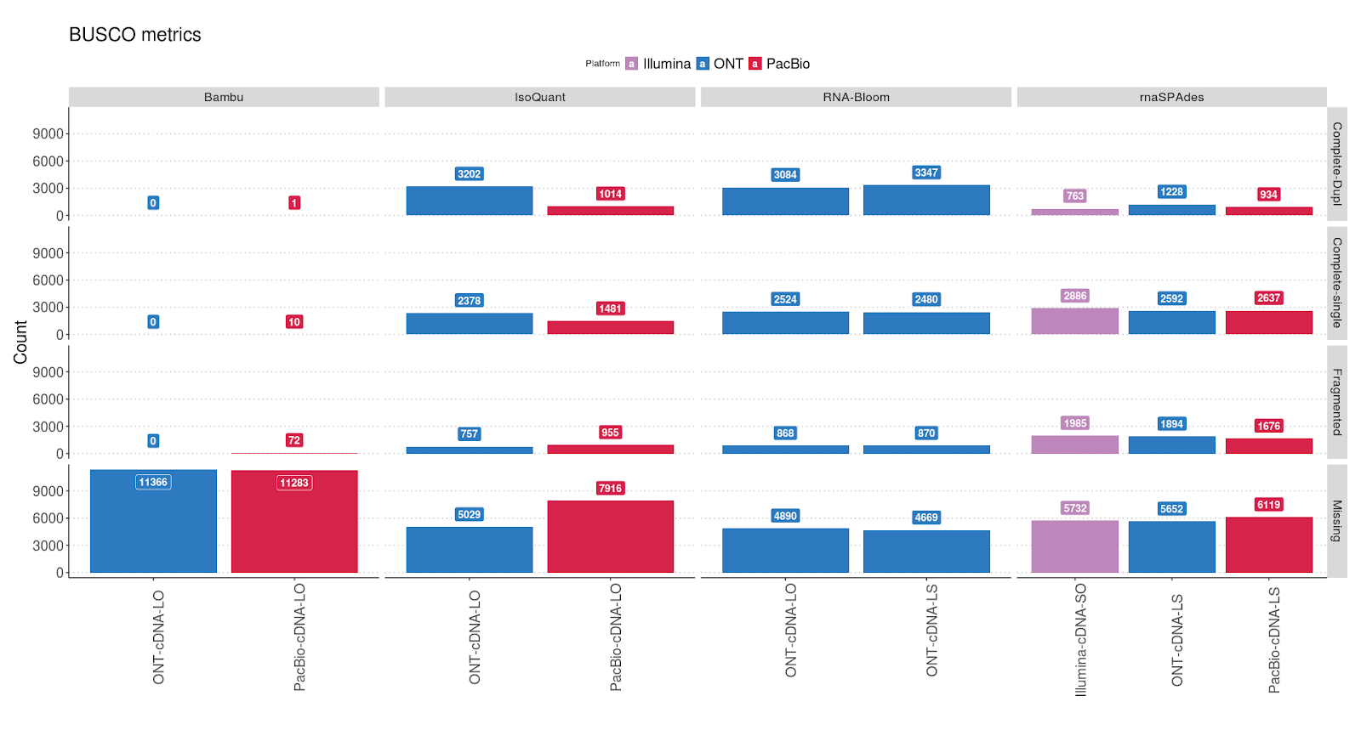
BUSCO Analysis

Slide 29
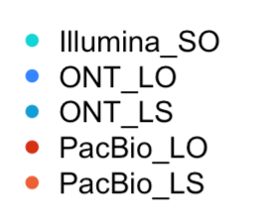
Functional annotation (Blast2GO)

Slide 30
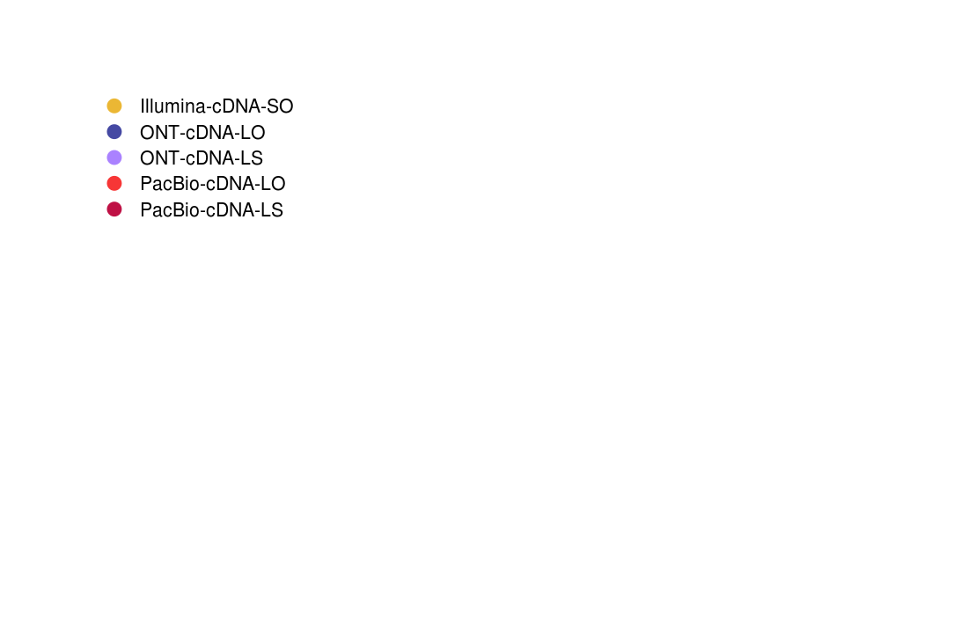
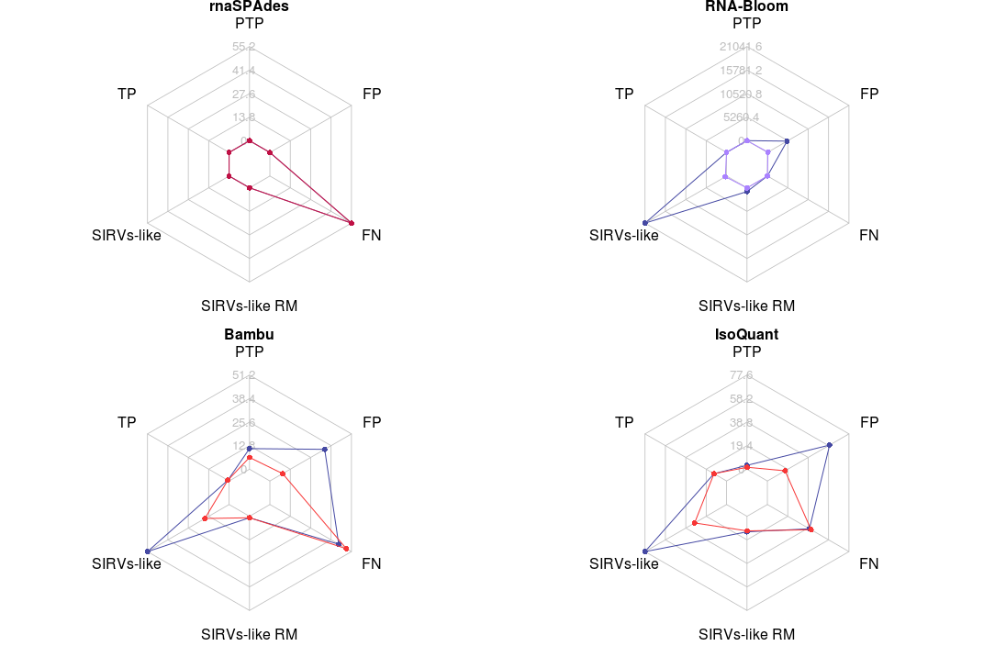
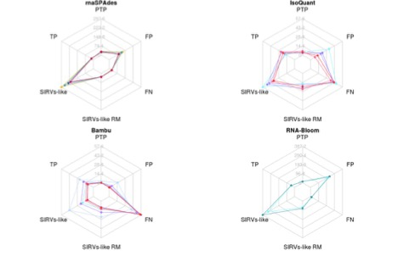
Evaluation Metrics for SIRVs (high proportion of SIRVs!!!)
Mouse sample
Mouse sample

Slide 31
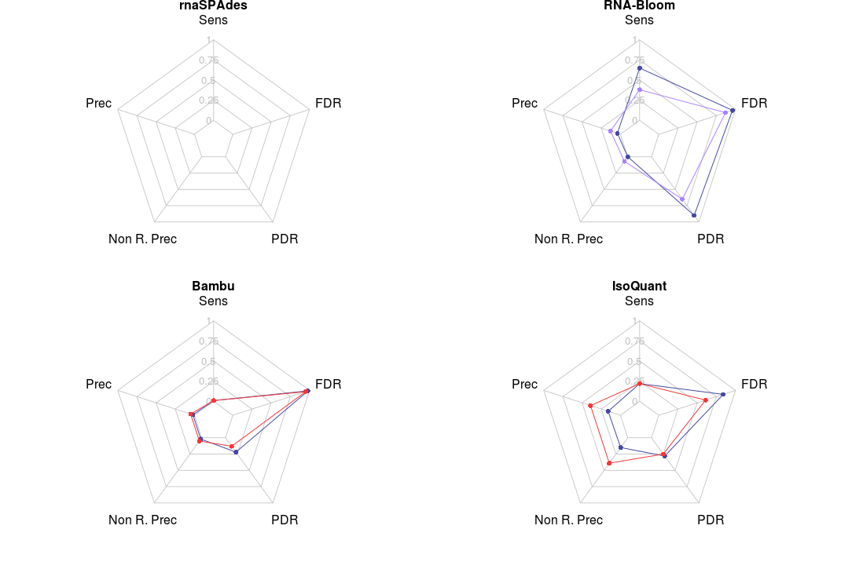
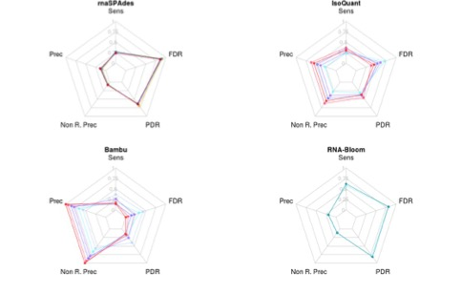
Evaluation Metrics for SIRVs
Mouse sample
Mouse sample

Slide 32
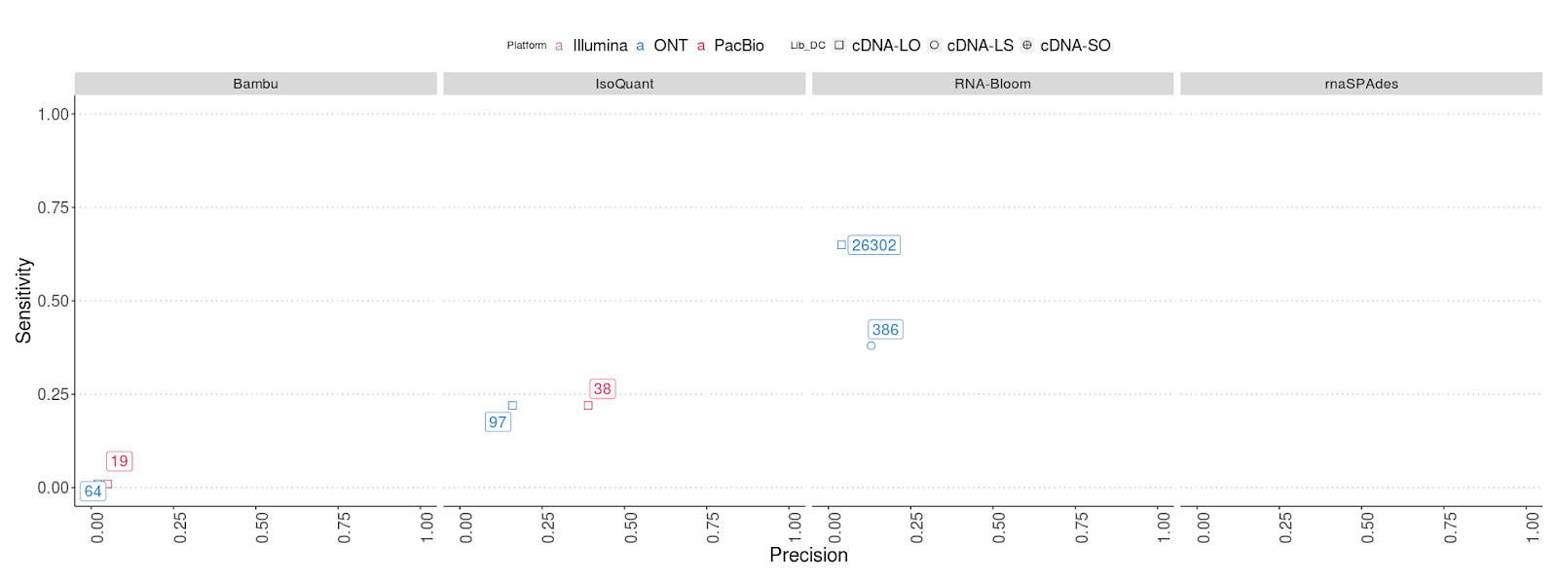
Sensitivity vs Precision

Slide 33
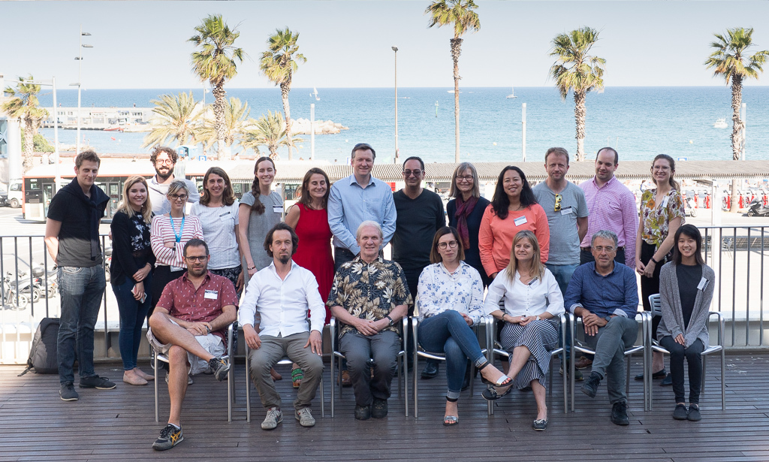
Acknowledgements
The LRGASP Evaluation Team
Ana Conesa and Fran Pardo (SQANTI developers)
Gloria Sheynkman (experimental validation lead)
Kin Fai, Dingjie Wang, Haoran Li (Challenge 2 evaluators)
Adam Frankish and Jane Loveland (GENCODE)
Mark Diekhans (UCSC Computational Genomics Lab)
Maite de Maria (UF)
Maggie Hunter (UF)
Nancy Denslow (UF)
The LRGASP consortium
Bambu Team
Birol Lab
SPbU Team

