Slide 1

LRGASP: Challenge 1
evaluation results
Francisco J. Pardo-Palacios, Ana Conesa
On behalf of the LRGASP evaluation team

Slide 2
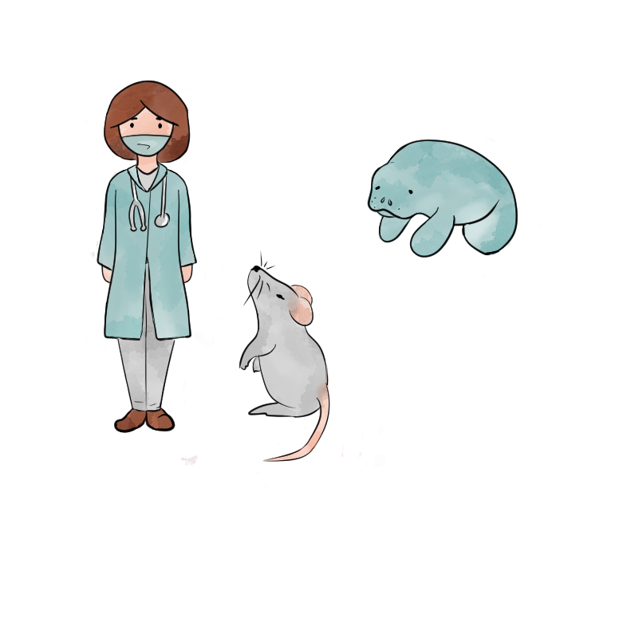

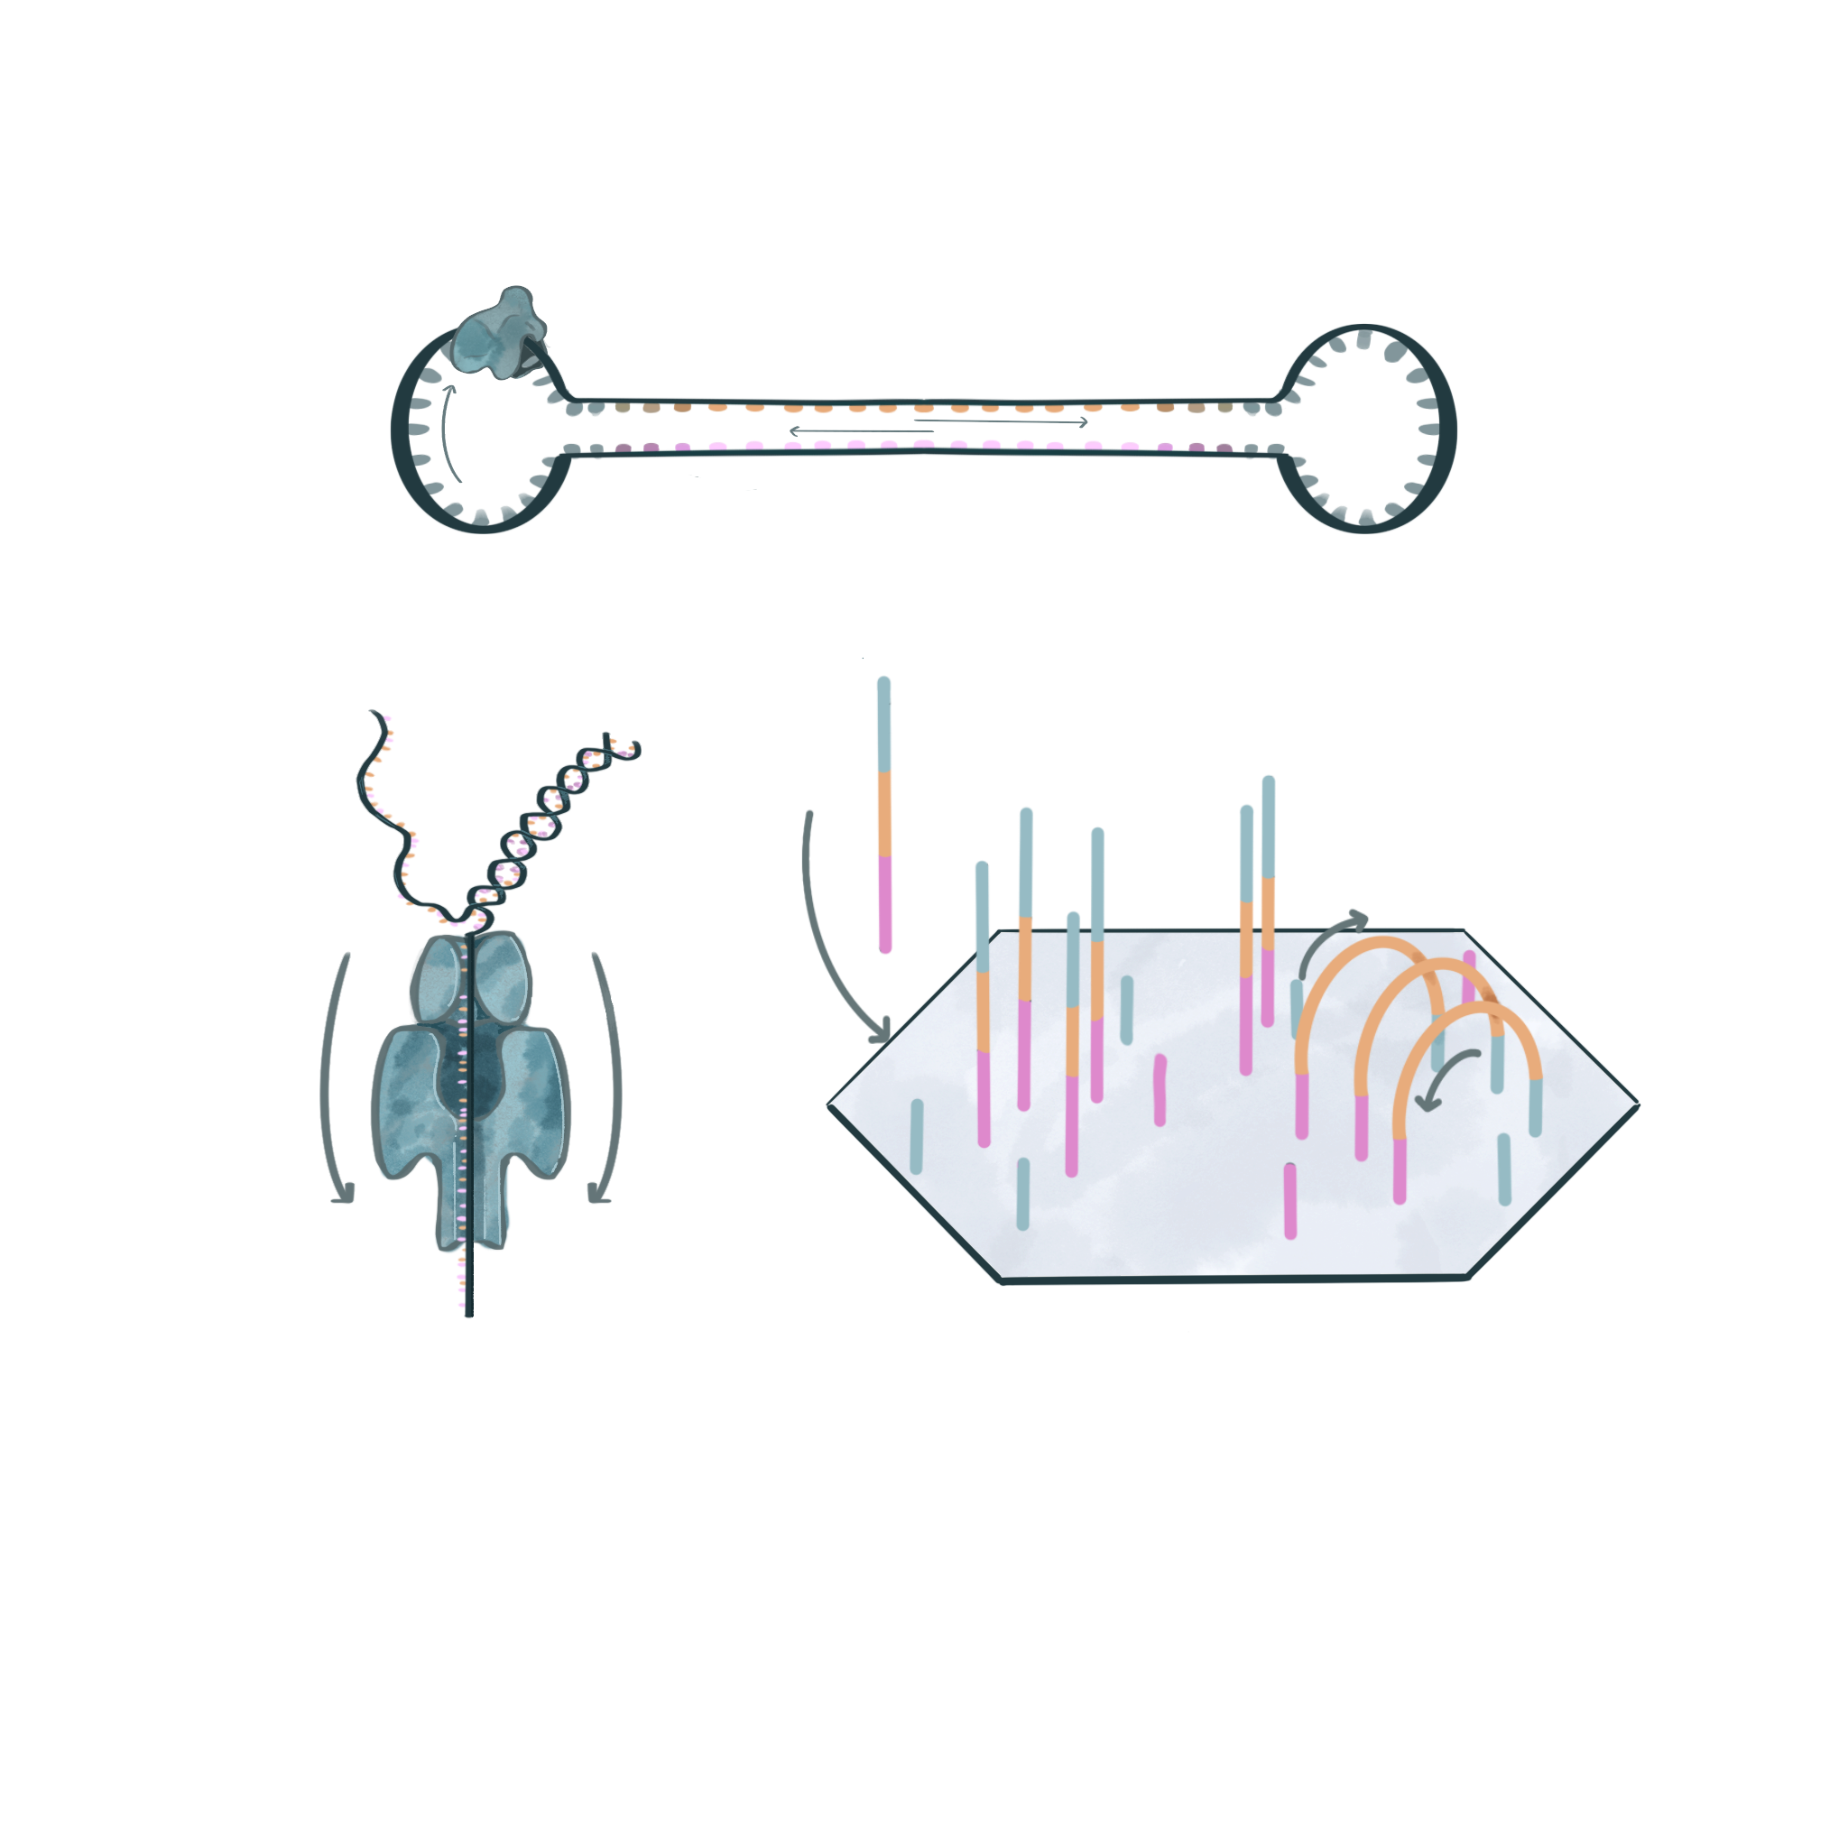
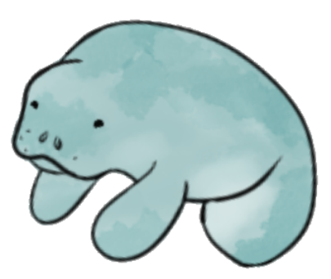
The LRGASP
3 species
4 sample types
4 library protocols
3 sequencing
platforms
cDNA
one cell type
Sequel II
human
direct RNA
cell mixtures
mouse
MinION
R2C2
spike-ins
manatee
synthetic data
CapTrap
HiSeq

Slide 3
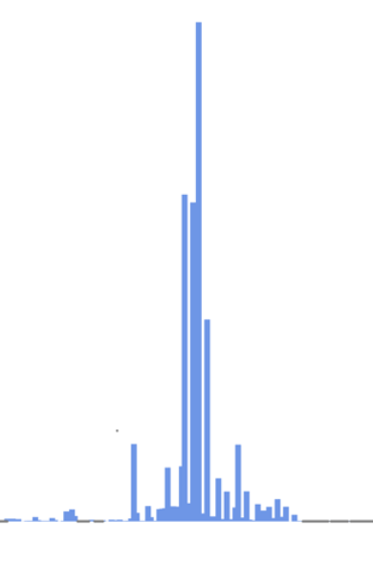
The LRGASP Challenge 1: Transcript identification
Sample types
Library protocols
Sequencing
platforms
Analysis options
Long Only
cDNA
WTC11, Mouse ES
Sequel II
direct RNA
Long & Short
H1 mix
MinION
Short only
R2C2
synthetic data
CapTrap
HiSeq
Free style

Slide 4
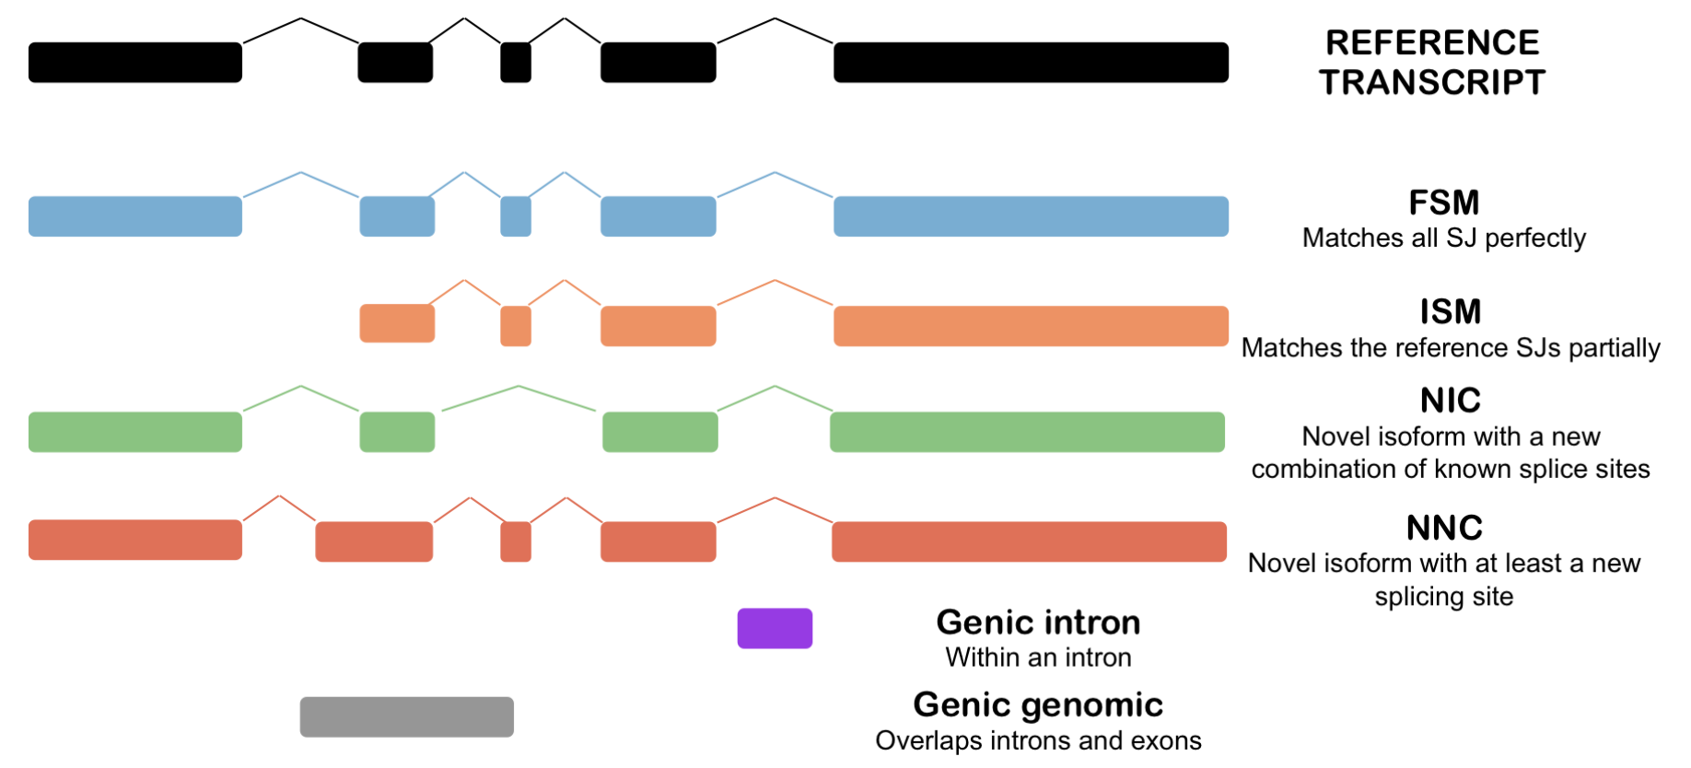
Evaluation is based on SQANTI categories
SQANTI was used to support part of the evaluation and create LRGASP evaluation metrics.

Slide 5
Evaluation code of conduct
The LRGASP evaluation team is composed by groups who did NOT participate in the challenge (did not submit predictions)
  Ana Conesa and Fran Pardo (SQANTI developers)
  Gloria Sheynkman (experimental validation lead)
  Kin Fai, Dingjie Wang, Haoran Li (Challenge 2 evaluators)
  Adam Frankish and Jane Loveland (GENCODE)
  Mark Diekhans (UCSC Genome Browser)
Results were discussed without disclosing the name of the submitting labs (only known to the Conesa lab)
Each lab received an evaluation report of their submissions
  One lab requested split the evaluation of SIRVs between short and long SIRVs

Slide 6
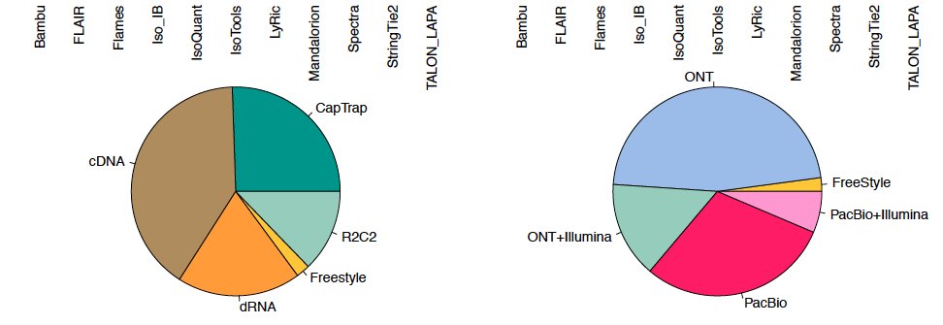
Overview of the participation effort
47 submissions from 11 different labs

Slide 7
Intersection analysis

Slide 8
Unique Junction Chain
We use Unique Junction Chain (UJC) to drive the comparison of detections across pipelines
Pipeline 1
Pipeline 2
UJC1
Pipeline 3
Pipeline 4
UJC2
Pipeline 5

Slide 9
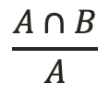
Pair-wise Relative Overlap
Overlap between two pipelines (A, B) in the detected genes / junctions / UJCs with respect to ONE of the pipelines ( rows in the heatmap)
$$\frac{A∩B}{A}$$
High overlap
Low overlap
Subgroup
A
B,C,D,…
A
B,C,D,…
A
B,C,D,…
A
A
A
A
A
A

Slide 10
Number of known genes detected (WTC11)
Main differences between library preps and tools used
  Lyric detect a reduced number of genes

Slide 11
Number of known genes detected (H1 mix)
Main differences between library preps and tools used
  Lyric detect a reduced number of genes

Slide 12
Number of known genes detected (mouse ES)
Main differences between library preps and tools used
  Lyric detect a reduced number of genes

Slide 13
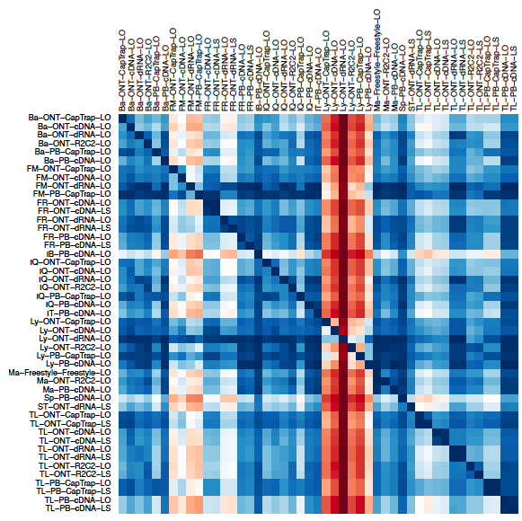
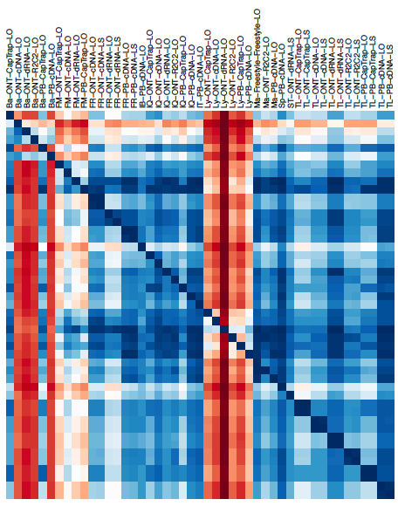
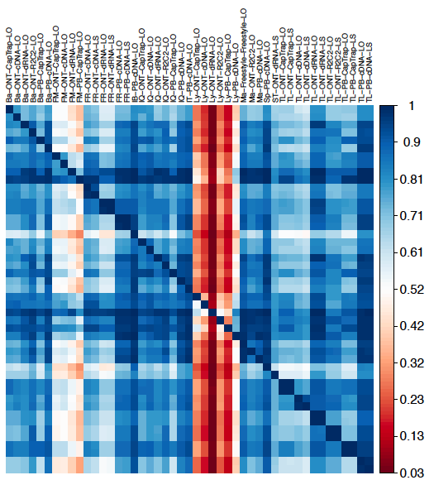
Relative overlap for known genes
Human WTC11
Human H1 mix
Mouse ES

Slide 14
Number of SJ detected (WTC11)
Two outliers:
  Spectra and IB submissions

Slide 15
Number of SJ detected (H1 mix)
Two outliers:
  Spectra and IB submissions

Slide 16
Number of SJ detected (mouse ES)
Two outliers:
  Spectra and IB submissions

Slide 17
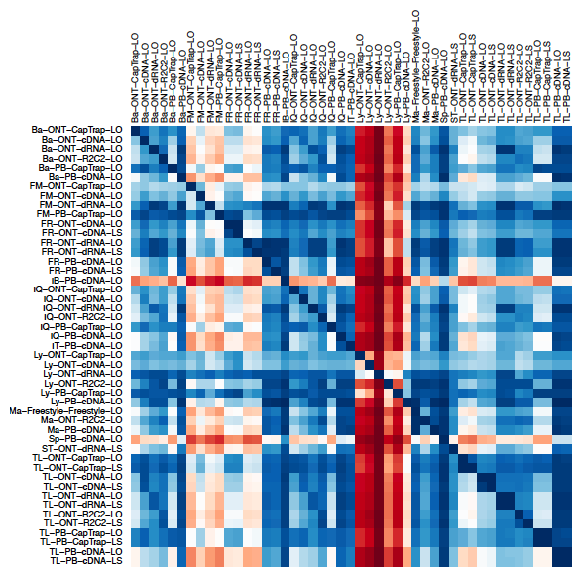
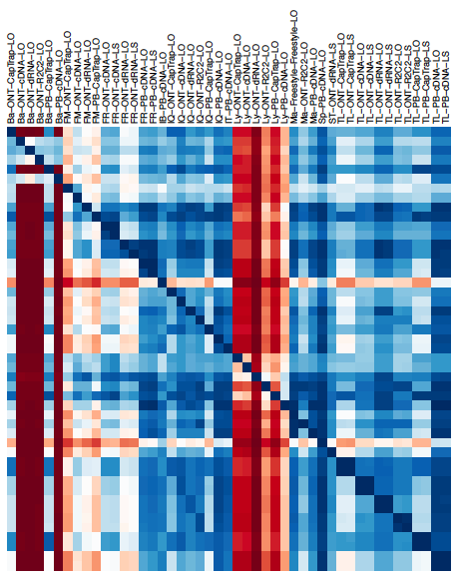
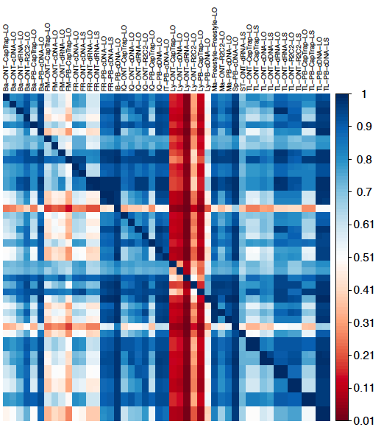
Relative overlap for splice junctions
Human WTC11
Human H1 mix
Mouse ES

Slide 18
Number of detected UJC
  The number of detected transcripts greatly varied between pipelines, but pipelines behave consistently across samples
Mouse ES
Human WTC11
Human H1 mix

Slide 19

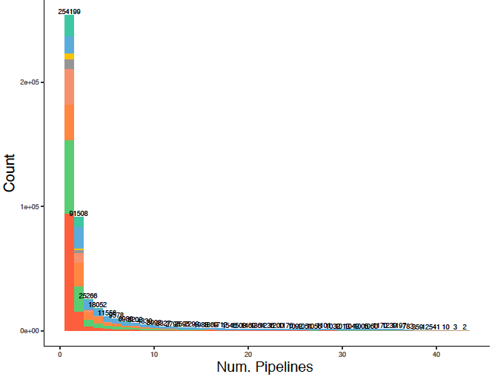
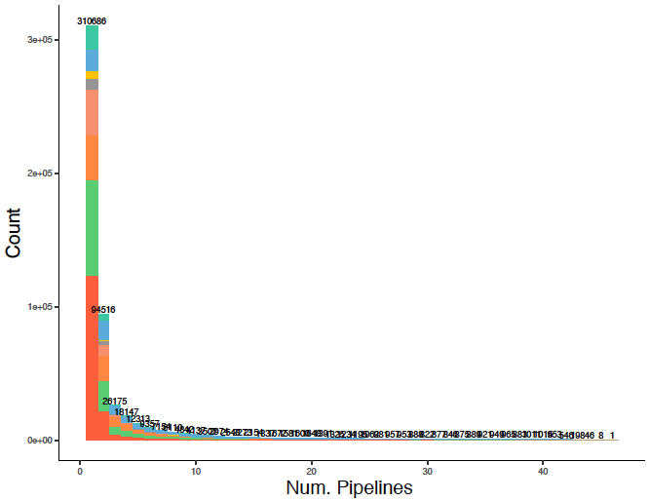
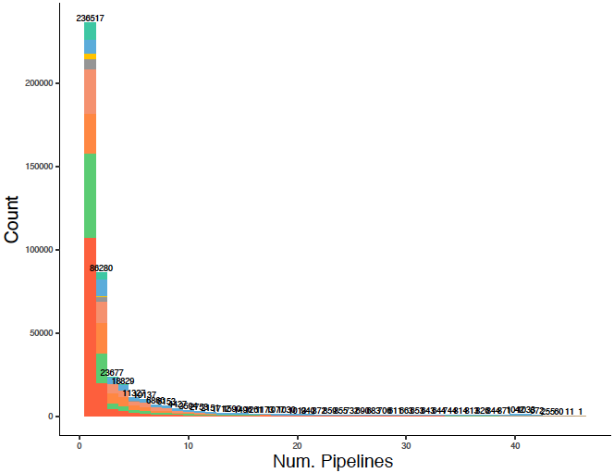
Identification of UJC
  Majority of UJC are only found by one pipeline, with special prevalence of NNC and NIC.
Human H1 mix
Human WTC11
Mouse ES

Slide 20
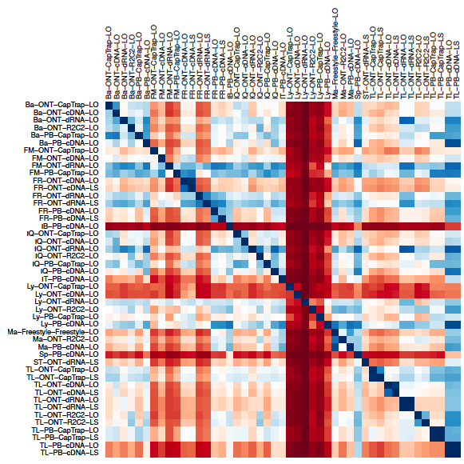
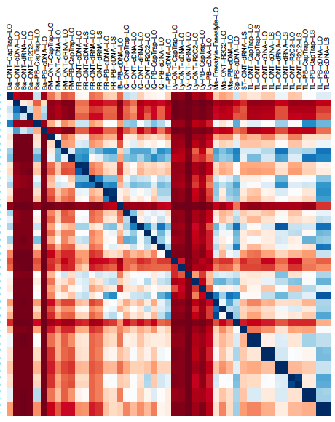
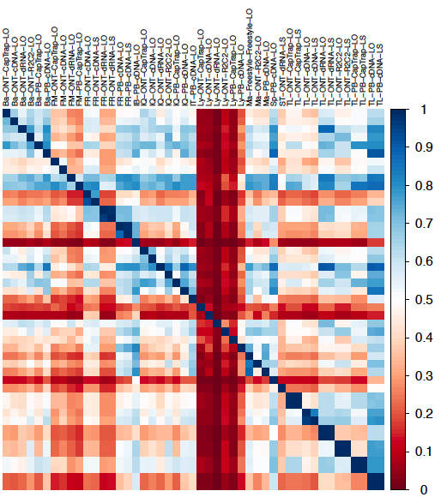
Relative overlap for UJC
Human WTC11
Human H1 mix
Mouse ES

Slide 21
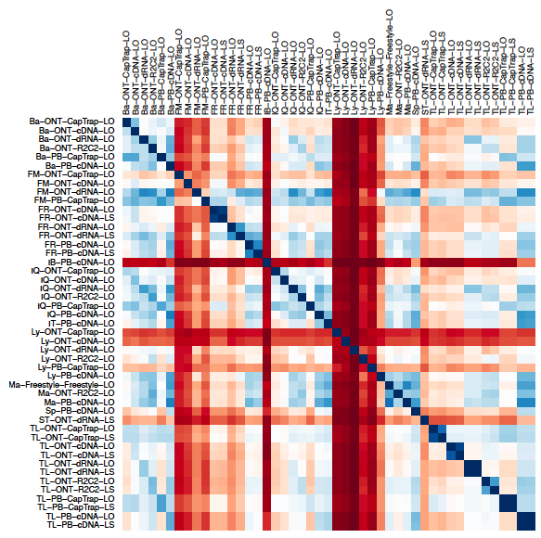
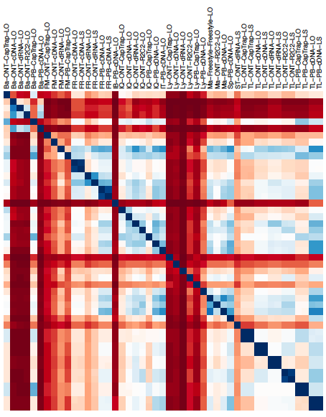
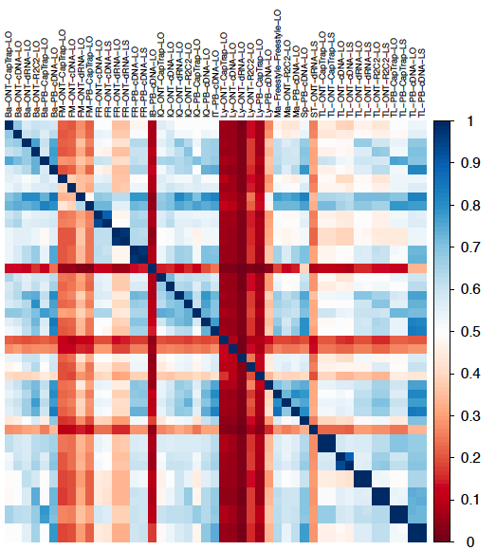
Relative overlap for dominant UJC per gene
Human WTC11
Human H1
Mouse ES
An UJC is considered dominant when it gathers more than 50% of the reads associated to its gene

Slide 22
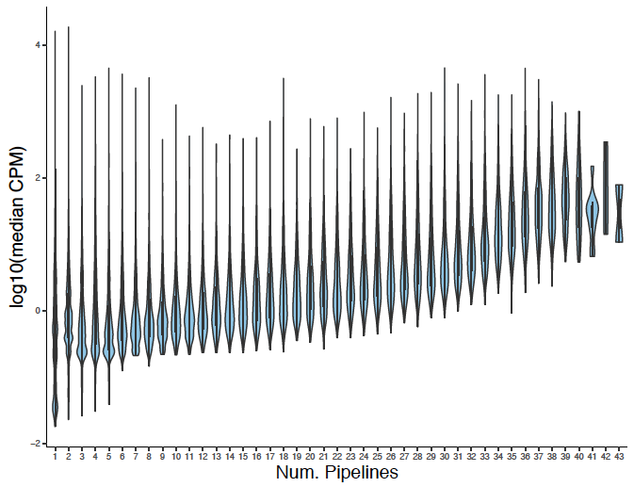
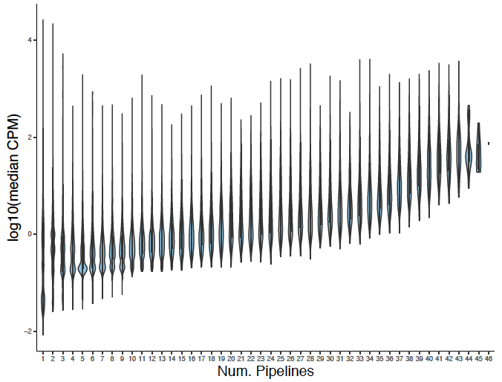
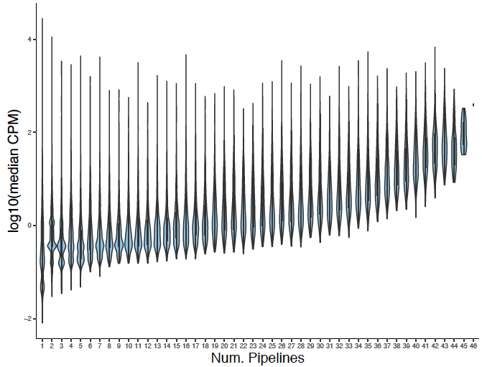
FSM UJC found by several pipelines vs log(median CPM)
  FSMs detected by more pipelines have higher CPMs, but some private
  FSMs have high CPM values too
Human H1 mix
Human WTC11
Mouse ES

Slide 23
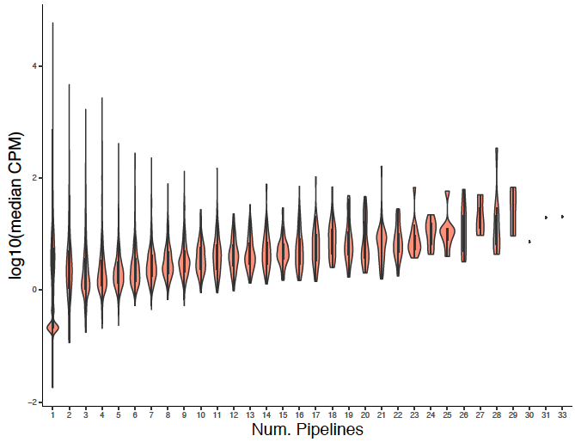
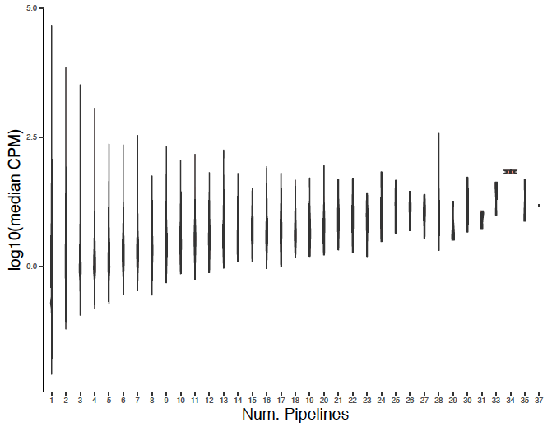
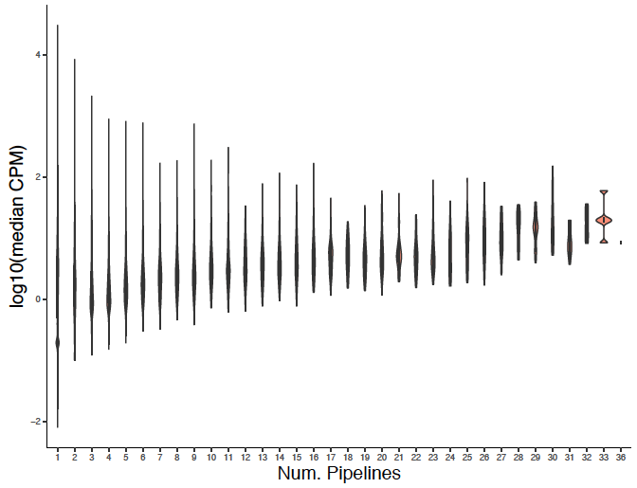
NNC UJC found by several pipelines vs log(median CPM)
  The relationship between NNC detection and number of pipelines has a lower dependence on CPM values
Human H1 mix
Human WTC11
Mouse ES

Slide 24
Platform detection patterns: %PB vs. %ONT

Slide 25
Platform detection patterns: %PB vs. %ONT

Slide 26
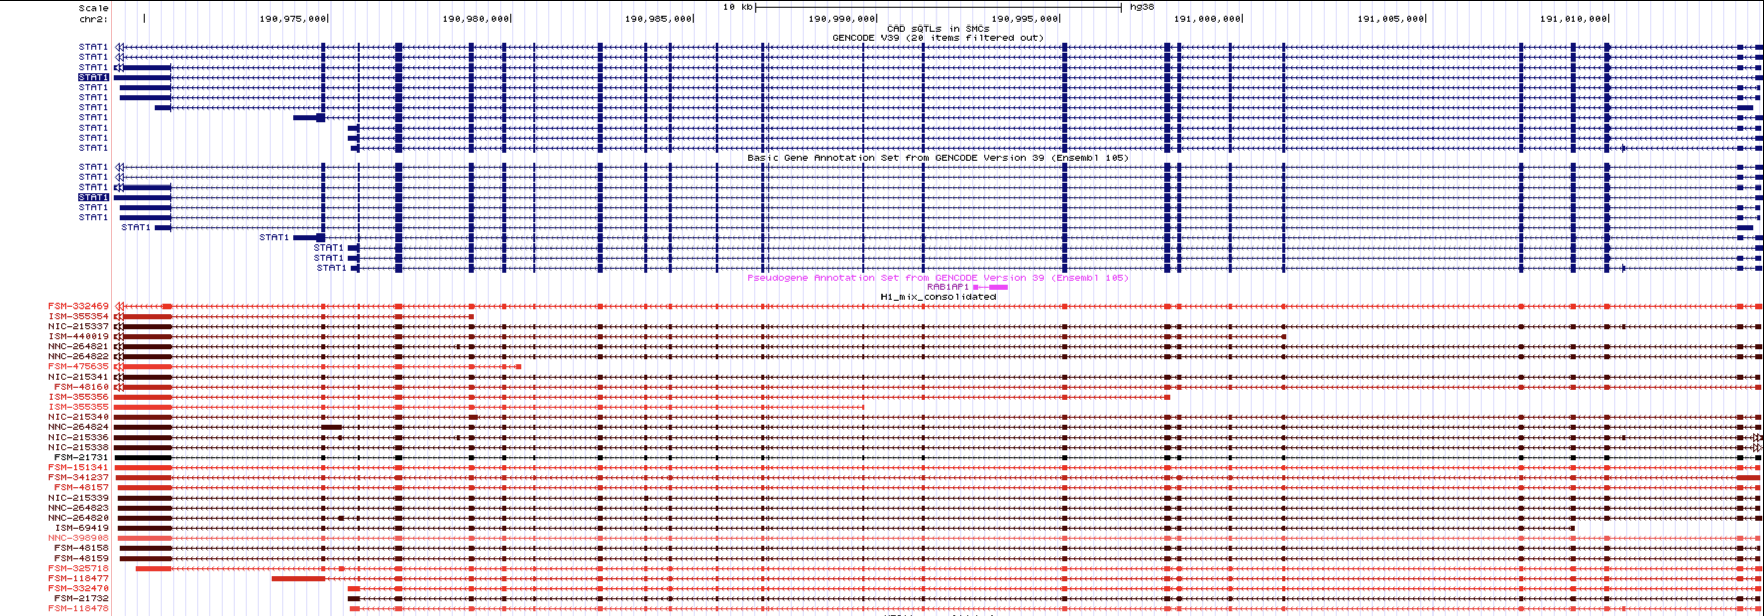
Genome Browser View
We have created UCSC GB tracks with all LRGASP data and annotations
STAT1 (good looking case)

Slide 27
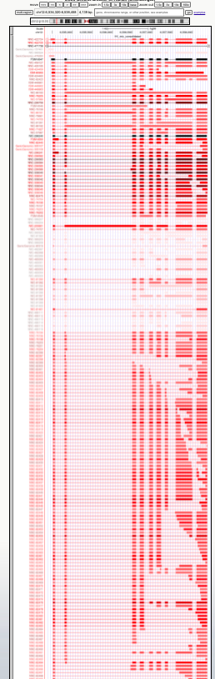
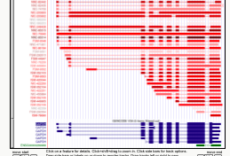
Genome Browser View
GADPH (not so good looking case)
LRGASP predictions
GENCODE annotation

Slide 28
Genome Browser View
How to visualize this track hub?
  Open UCSC Genome Browser main page
  Go to “My Data” → ”Track Hubs”
  Go to “My Hubs” tab and paste this URL:
    http://conesalab.org/LRGASP/LRGASP_hub/hub
  Press ”Add Hub” and select which assembly you want to visualize
    hg38 is for human samples. Both H1 mix and WTC11 tracks will be shown, but it is posible to hide any of them and keep the other
    mm39 is for mouse ES simple
Things you need to know:
  They are UJC → the information about the actual isoforms reported by the submitters is collapsed
    If you want to know how many submissions reported an UJC, click on it.
    It’s “blinded”, so you can’t see who submitted a certain UJC, only which platform/libary prep/data was used
  Color code stands for the abundance (as mean CPM across pipelines that detected that UJC) within that gene, so it’s relative to the gene expression
    The darker, the more reads were associated to that UJC

Slide 29
Comparative evaluation for all data

Slide 30
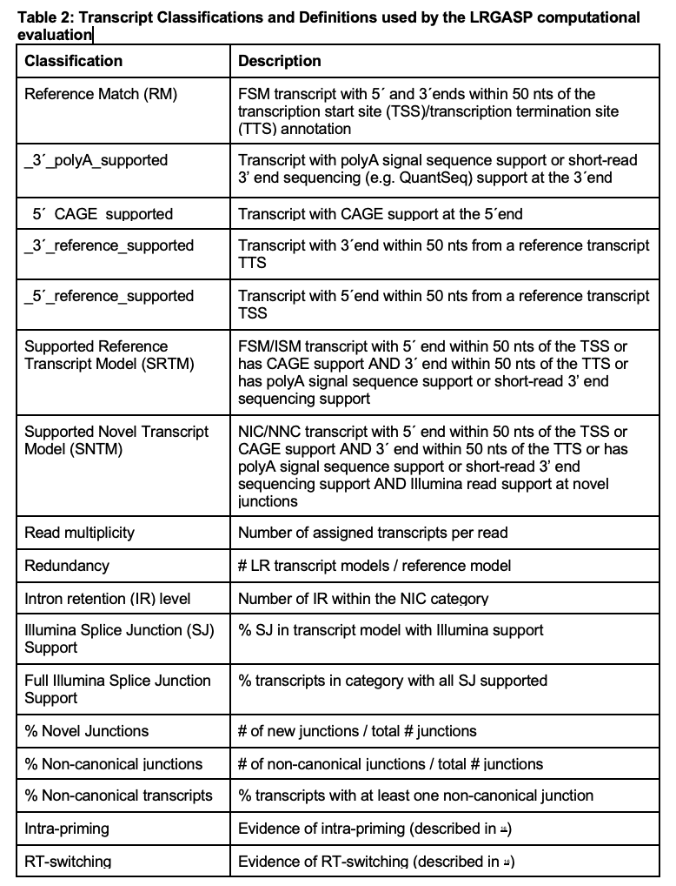
Metrics for All Transcripts evaluations

Slide 31
FSM: 5’ reference support vs 3’ reference support
Human WTC11
Mouse ES
Human H1 mix

Slide 32
FSM: CAGE support vs. polyA support
Human WTC11
Mouse ES
Human H1 mix

Slide 33
ISM: CAGE support vs. polyA support
Human WTC11
Mouse ES
Human H1 mix

Slide 34
% NIC SNTM vs % NNC SNTM
Human WTC11
Mouse ES
Human H1 mix

Slide 35
NNC: % Full Illumina support vs Non canonical SJ
Human WTC11
Mouse ES
Human H1 mix

Slide 36
Comparative evaluation for SIRVs

Slide 37
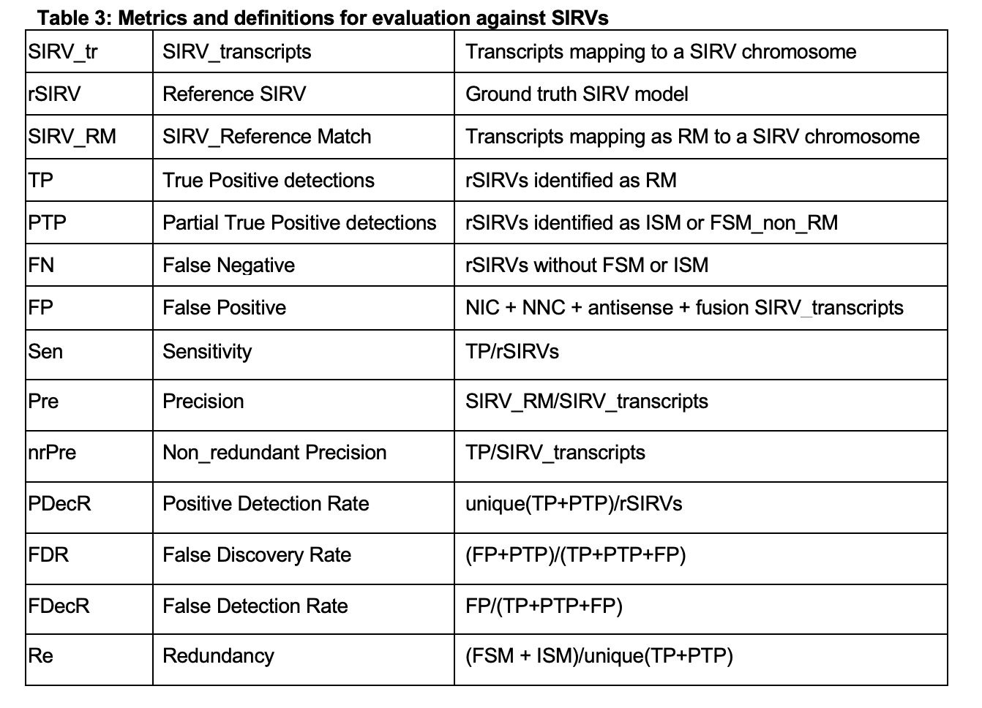
Evaluation Metrics for SIRVs

Slide 38
Number of reported SIRVs
Mouse ES
Human WTC11
Human H1 mix

Slide 39
SIRV metrics

Slide 40
SIRV metrics

Slide 41
SIRVs : Sensitivity vs Precision

Slide 42
Simulated data

Slide 43
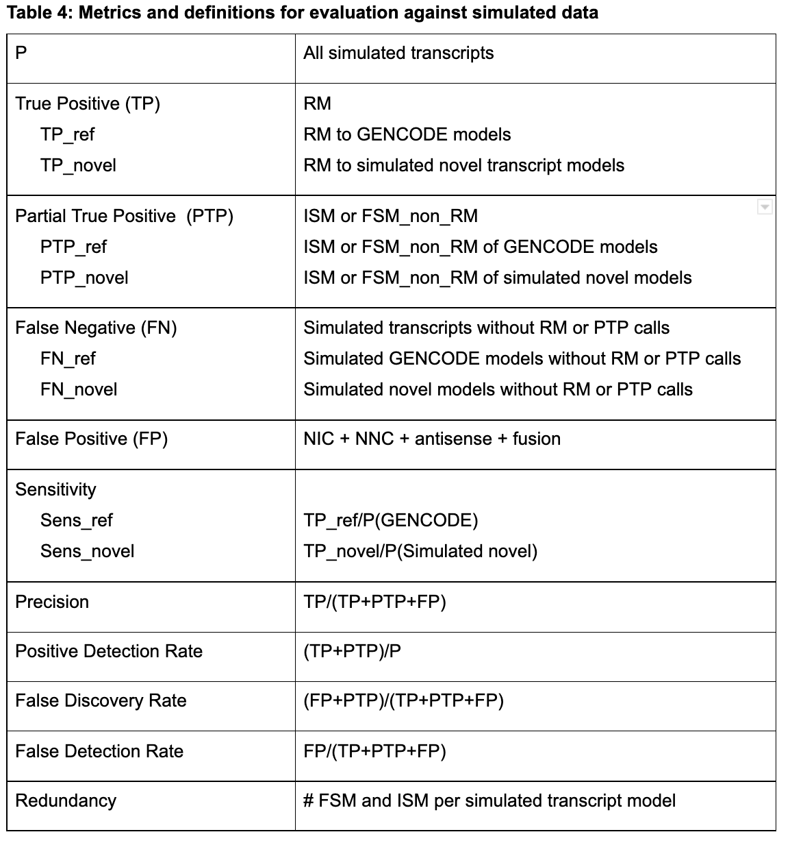
Simulation description
ONT : NanoSim using pre-trained cDNA and dRNA reads
PacBio: IsoSeqSim estimating error rates from LRGASP data
Illumina: RSEM simulator
We simulated “true” novel transcripts by mapping mouse transcripts Into the human genome and viceversa
  They are novel isoforms of known genes with canonical SJs

Slide 44
Simulation: comparison of results
Human simulation:

Slide 45
Simulation: comparison of results
Human simulation:
  Sensitivity vs Precision

Slide 46
Simulation: comparison of results
Human simulation:
  F1 score

Slide 47
Simulation: comparison of results
Human simulation:
  Increased sensitivity when expression is higher

Slide 48
Simulation: comparison of results
Human simulation:
  Sensitivity values for “known” and “novel” simulation

Slide 49
Simulation: comparison of results
Mouse simulation:

Slide 50
Simulation: comparison of results
Mouse simulation:
  Sensitivity vs Precision

Slide 51
Simulation: comparison of results
Mouse simulation:
  F1 score

Slide 52
Simulation: comparison of results
Human simulation:
  Increased sensitivity when expression is higher

Slide 53
Simulation: comparison of results
Mouse simulation:
  Sensitivity values for “known” and “novel” simulation

Slide 54
Next actions….
Define follow up questions
Detailed analysis by experimental factor (e.g. library prep)
Improve stratified analyisis (by expression value, transcript length)
Select validation targets

Slide 55
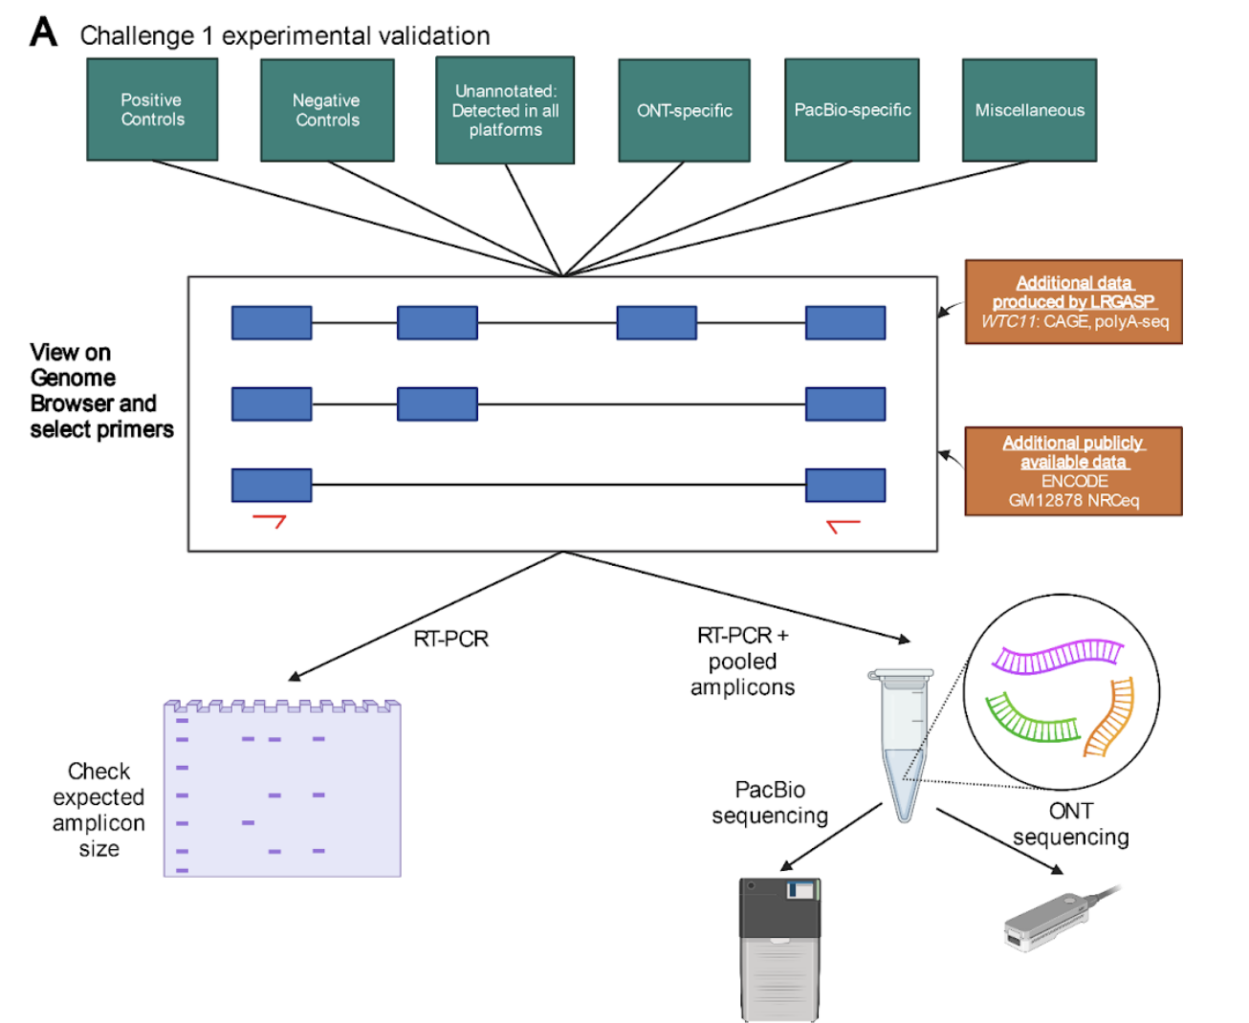
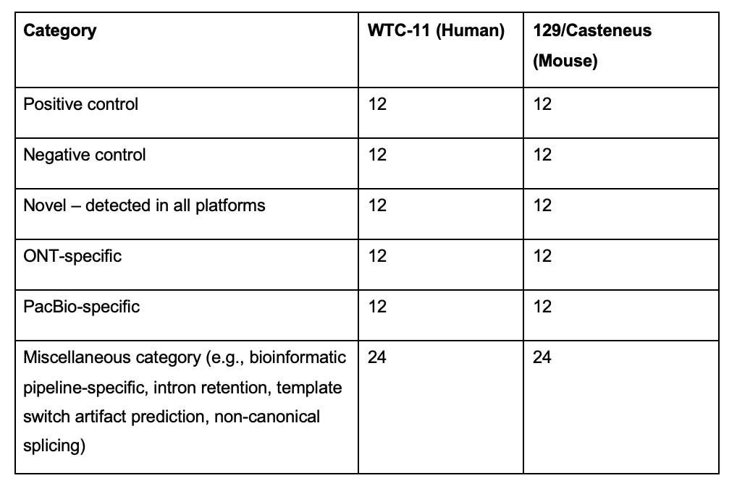
Challenge 1 Validation Experimental Design in Progress

Slide 56
Selection of validation targets
Genes that are moderately abundant (10 TPM or higher based on short-read RNA-seq estimations)
Genes that produce transcripts that are moderate in length (1-4kb)
Positive controls are Unique Junction Chains that are present in 50% or more pipelines and in GENCODE v39
Negative controls are UJCs that are found in human specimens, but without any evidence of expression in WTC-11

Slide 57
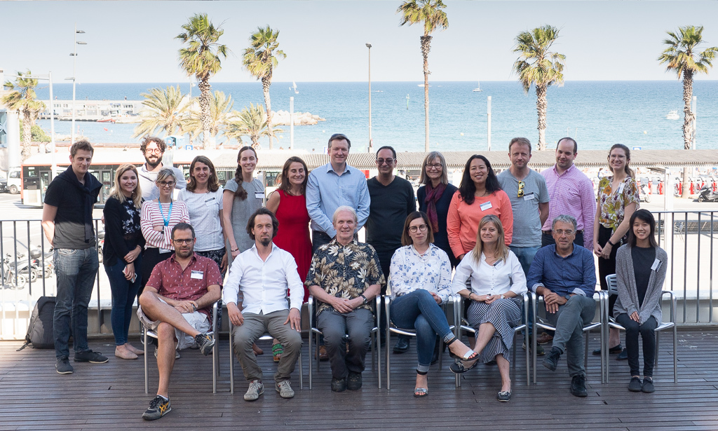
Acknowledgements
The LRGASP Evaluation Team
Ana Conesa and Fran Pardo (SQANTI developers)
Gloria Sheynkman (experimental validation lead)
Kin Fai, Dingjie Wang, Haoran Li (Challenge 2 evaluators)
Adam Frankish and Jane Loveland (GENCODE)
Mark Diekhans (UCSC Genome Browser)
The LRGASP consortium
Bambu Team
Brooks Lab
Guigó Lab
IsoTools Team
Kawaji Lab
Ritchie Lab
Tilgner Lab
Mortazavi Lab
JHU Pertea Lab
IB Lab
Vollmers Lab

